Slide 1
Build a Watson AI Chatbot from Db2
Sanjula Ganepola, IBM
Software Developer
sanjula.ganepola@ibm.com

Slide 2
Agenda
Overview of Watsonx Assistant
Planning Your Assistant
Terminology You Should Know
Let’s Build a Chatbot
Integrate with Db2
Next Steps

Slide 3
Overview of Watsonx Assistant

Slide 4
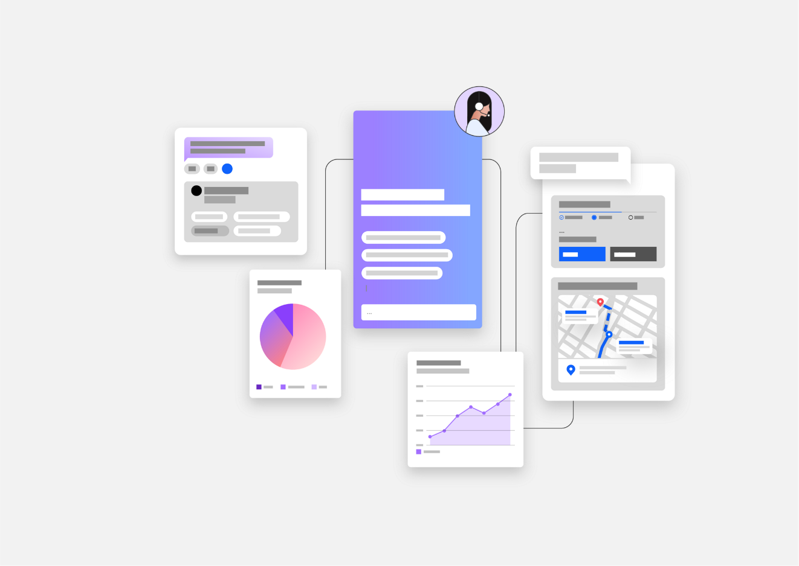
What is Watsonx Assistant?
“Conversational AI solution that empowers anyone to effortlessly build generative AI Assistants that deliver frictionless self-service experiences to customers”
↓
Use Watsonx Assistant to build your own branded live chatbot
💻 Bring the assistant to your customers, where they are
🧠 Create AI-driven conversational flows
📑 Embed existing help content
🤝 Connect to your customer service teams
🎯 Track customer engagement and satisfaction

Slide 5
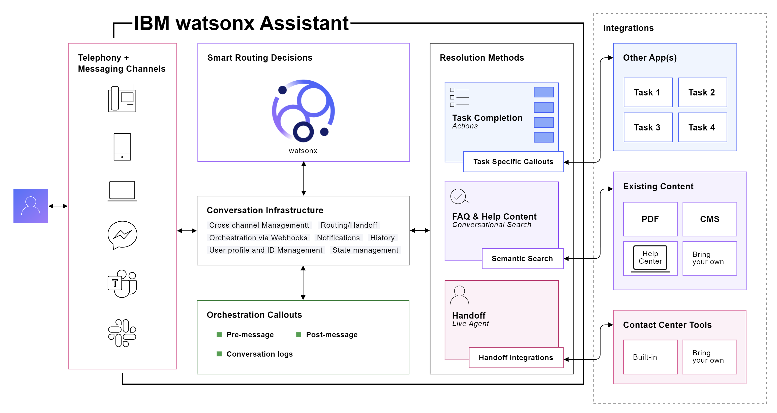
How Does It Work?

Slide 6
Planning Your Assistant

Slide 7
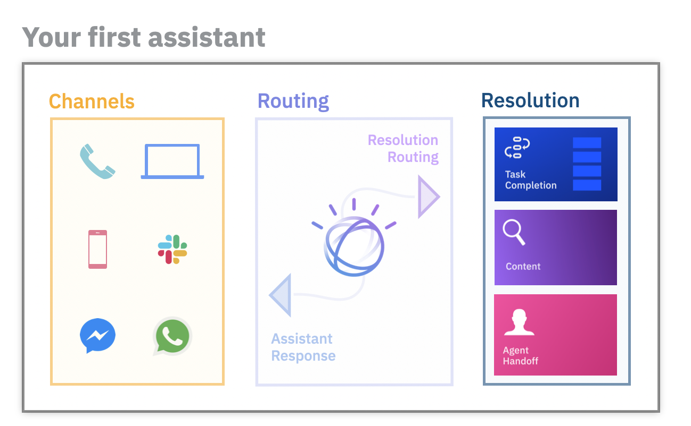
Before building an assistant…
Select an initial channel
Where will customers use your assistant?
Select starting domain
What topic domain can your assistant unify and automate?
Outline frequent topics
What are the most frequent topics which are mostly informational in nature?
Collect content sources
What help content is available to customers today?
Plan handoff strategy
How should customers be routed to human agents?

Slide 8
Terminology You Should Know

Slide 9
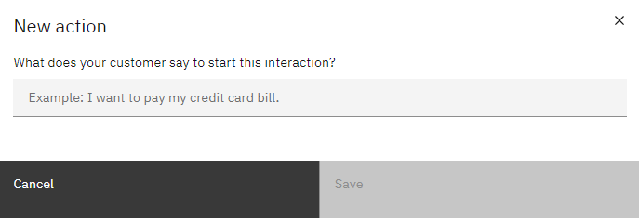
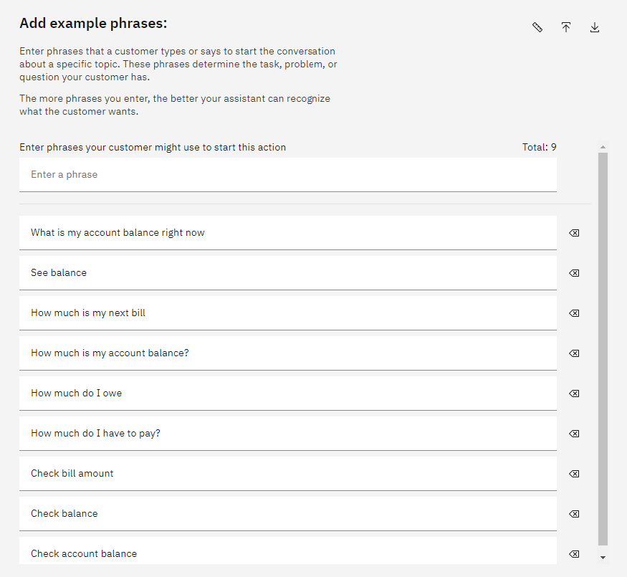
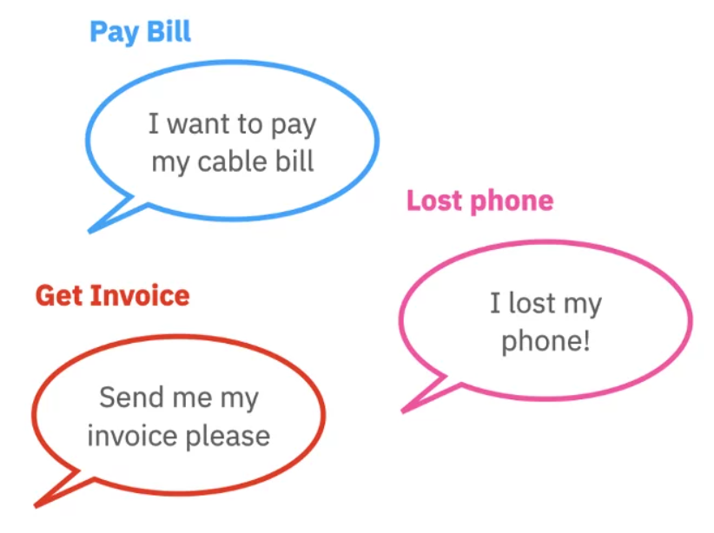
What are Actions and Phrases?
An action is a problem or a task that your customer wants to resolve
Phrases are what customers type or say to start an action
Add multiple phrases to better train your assistant to recognize what customers want

Slide 10
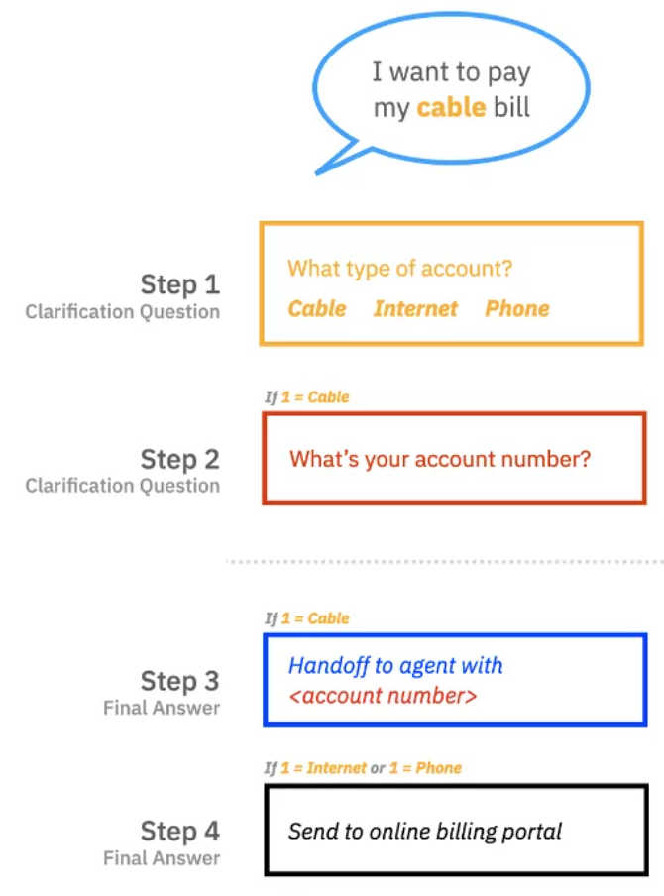
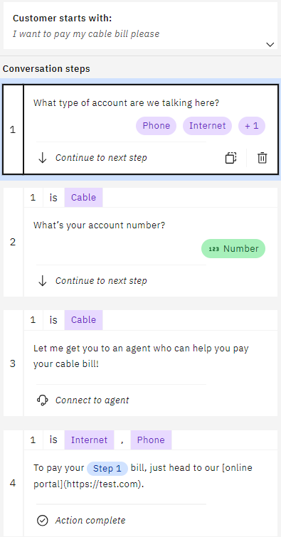
What are Steps and Conditions?
A step is a back-and-forth interaction between your assistant and your customer
Conditions are requirements which must be met for the step to be triggered

Slide 11
Let’s Build a Chatbot

Slide 12




Demo Example – ConnectMe Inc.
ConnectMe Inc. is a telecommunications company with cable, internet, and phone services
ConnectMe Inc.
Goals
Streamline bill payment services
Update account data in real-time
Provide 24/7 support
Customer A
Support Rep A
Database
Customer B
Support Rep B
FAQ Manual

Slide 13
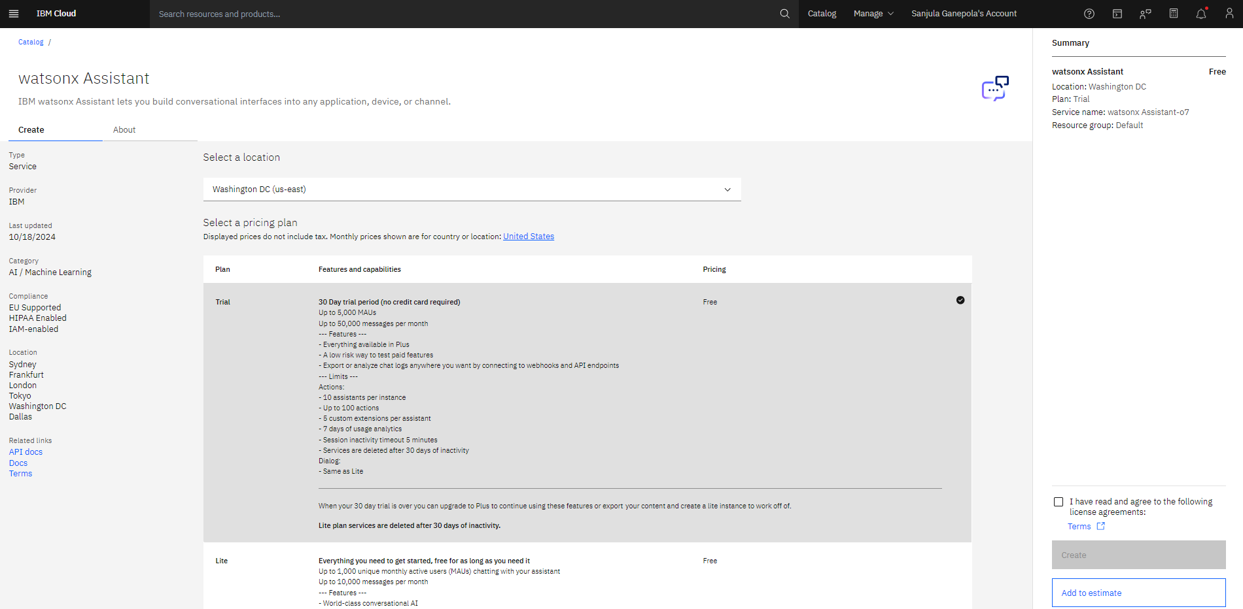
Create Watsonx Assistant Instance

Slide 14
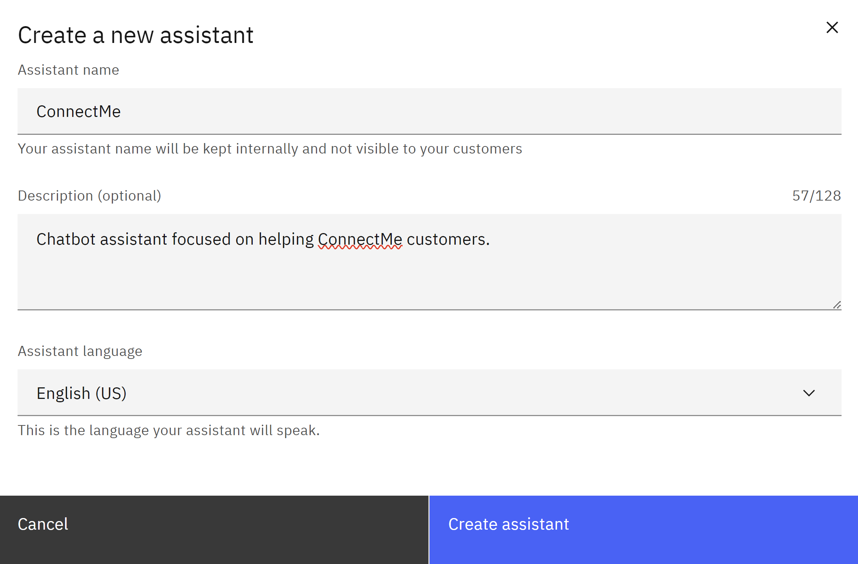
Create Watsonx Assistant

Slide 15
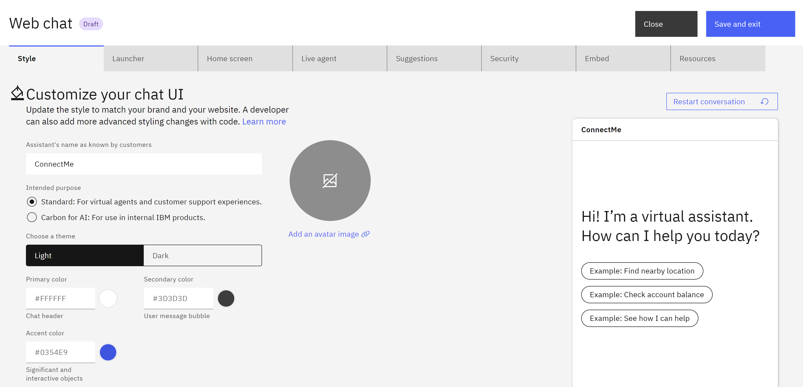
Customize Web Chat

Slide 16
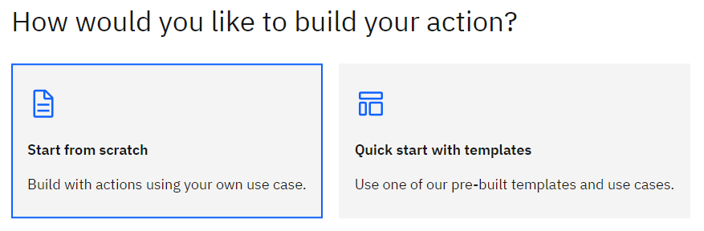
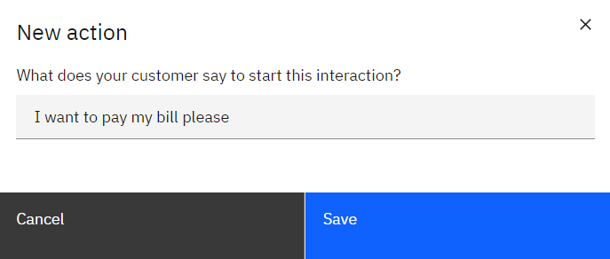
Create Action From Scratch and Set Initial Phrase

Slide 17
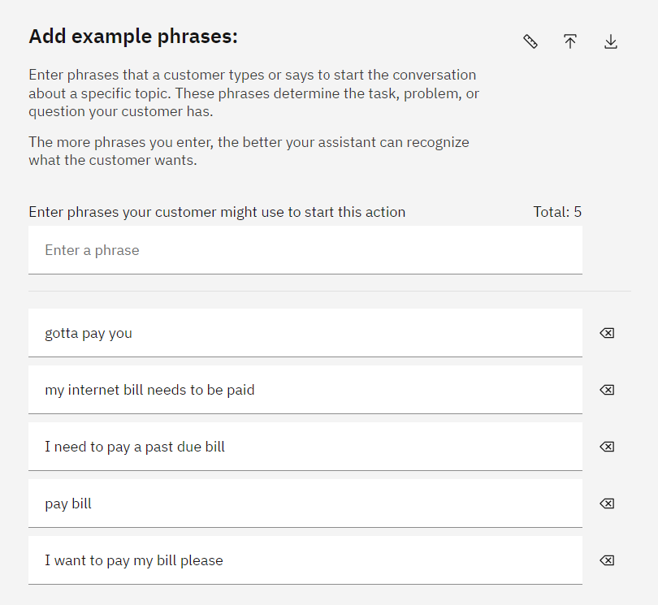
Add More Example Phrases
⭐

Slide 18
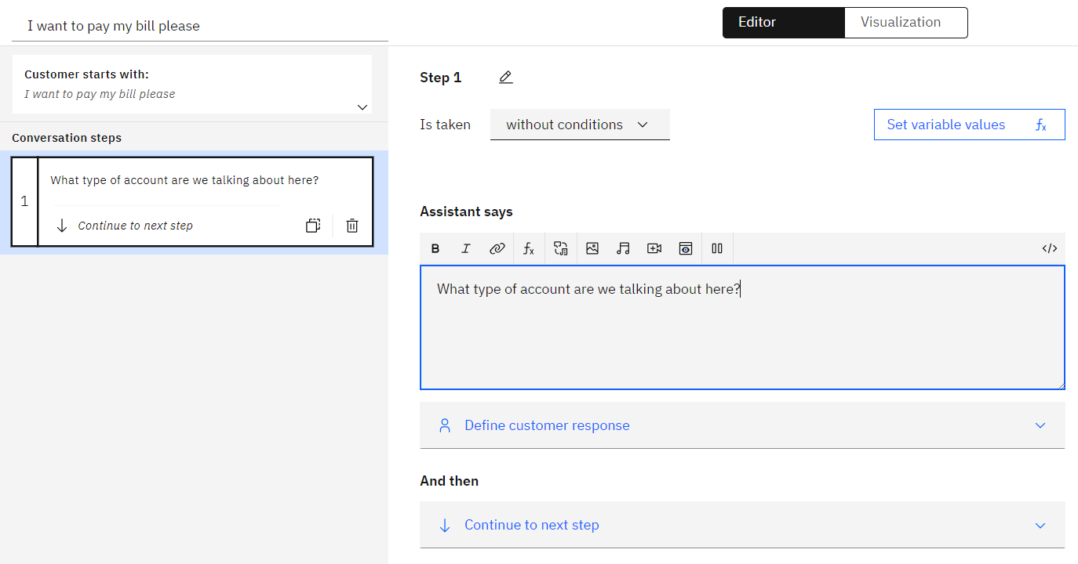
Create First Step

Slide 19
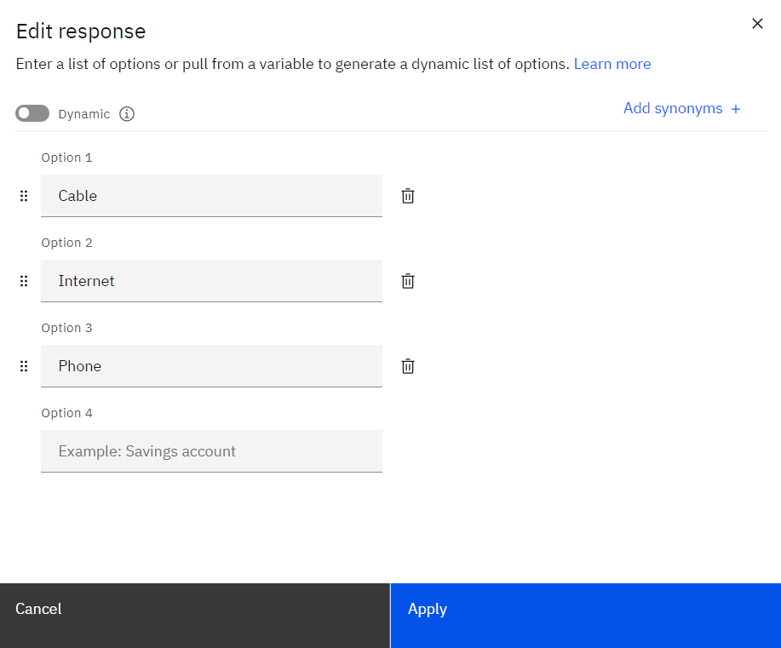
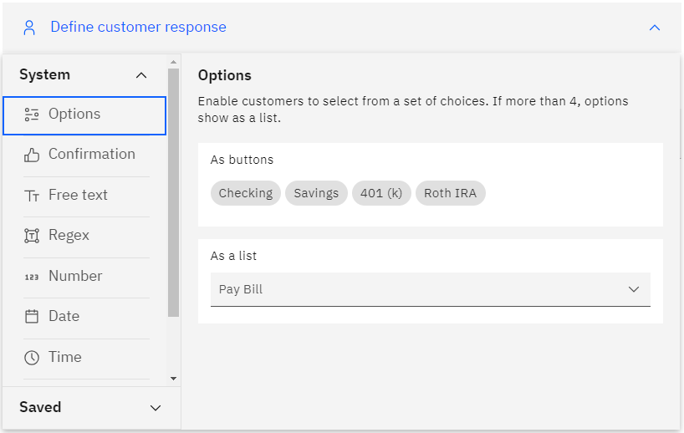
Add Custom Response Options

Slide 20
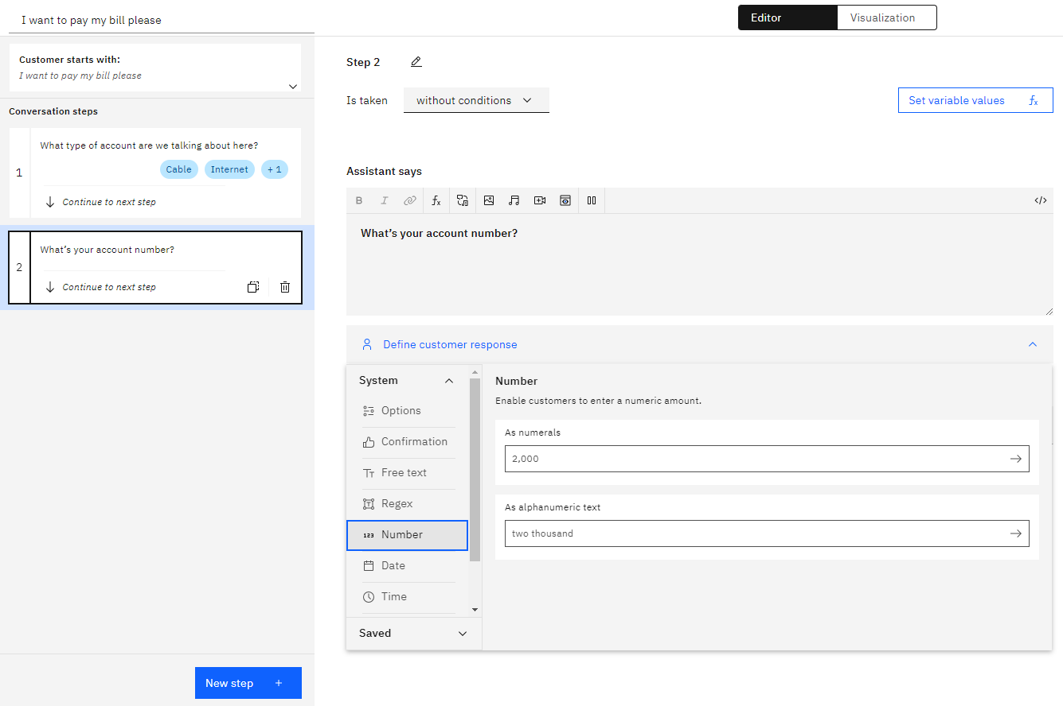
Create Another Clarification Step

Slide 21
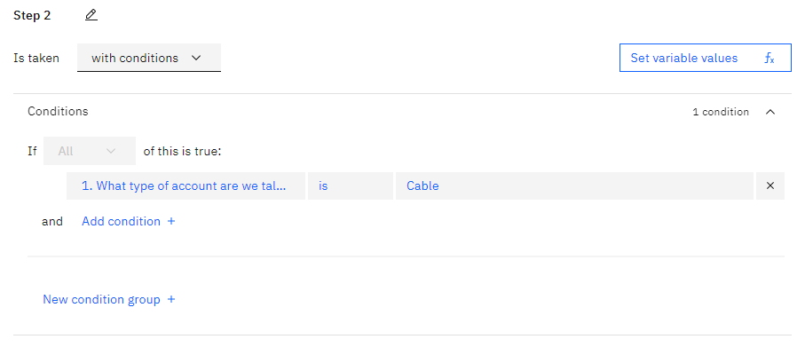
Add Condition

Slide 22
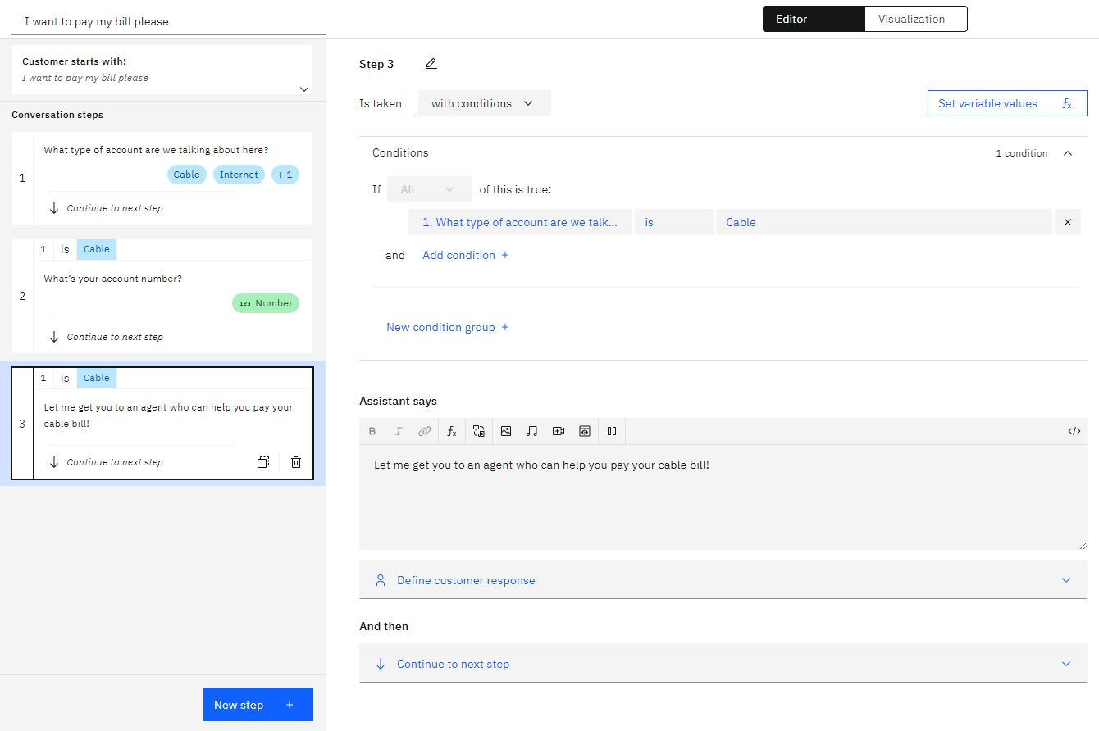
Create an Agent Handoff Step

Slide 23
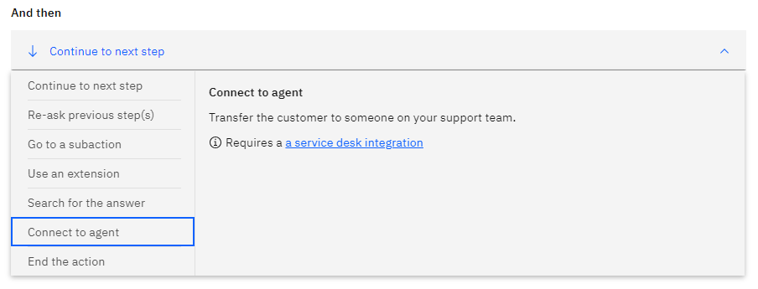
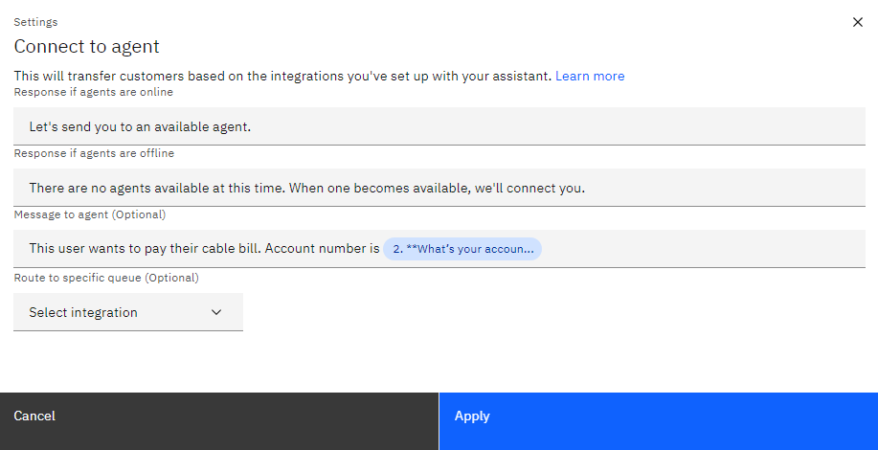
Connect to Agent

Slide 24
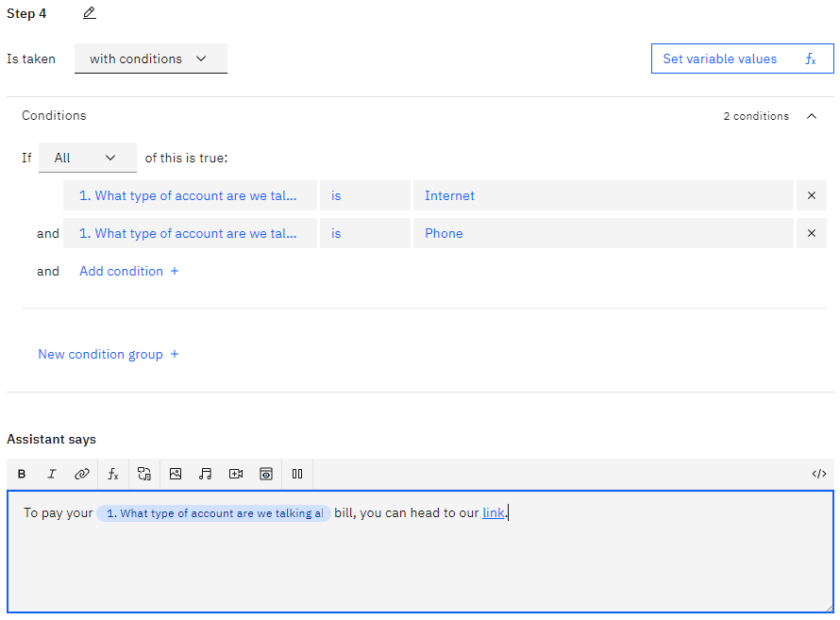
Create Final Response Step

Slide 25
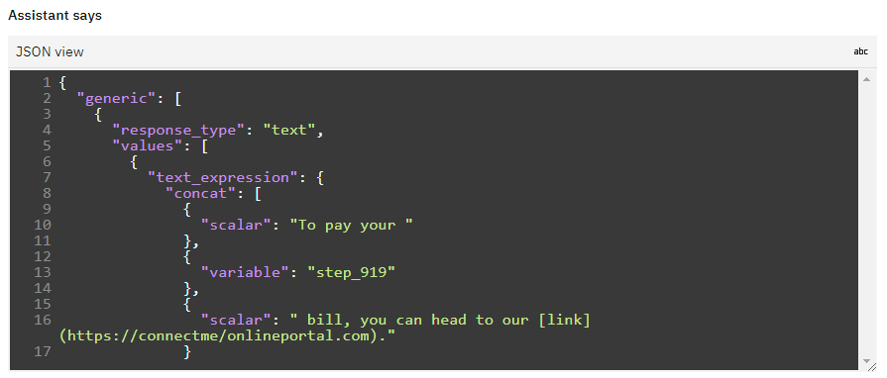
Edit Response in JSON View

Slide 26
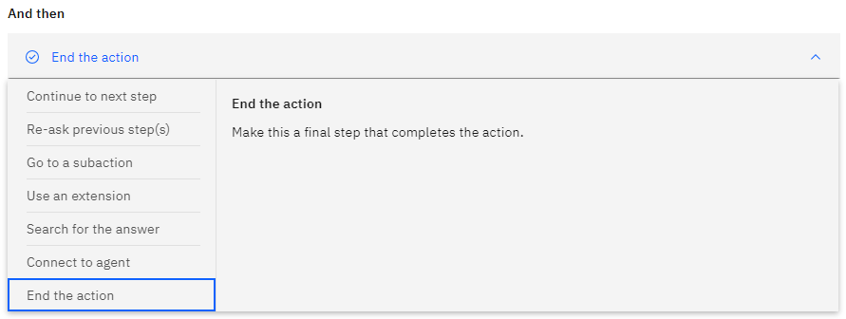
End the Action

Slide 27
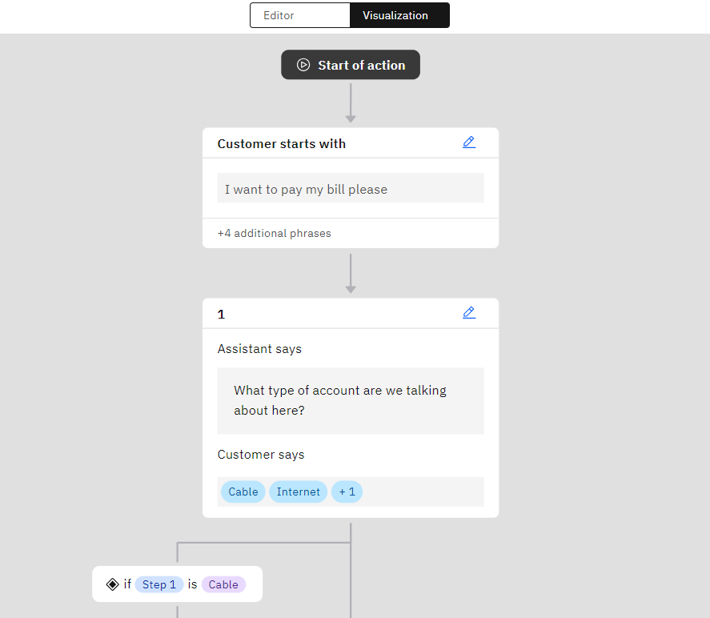
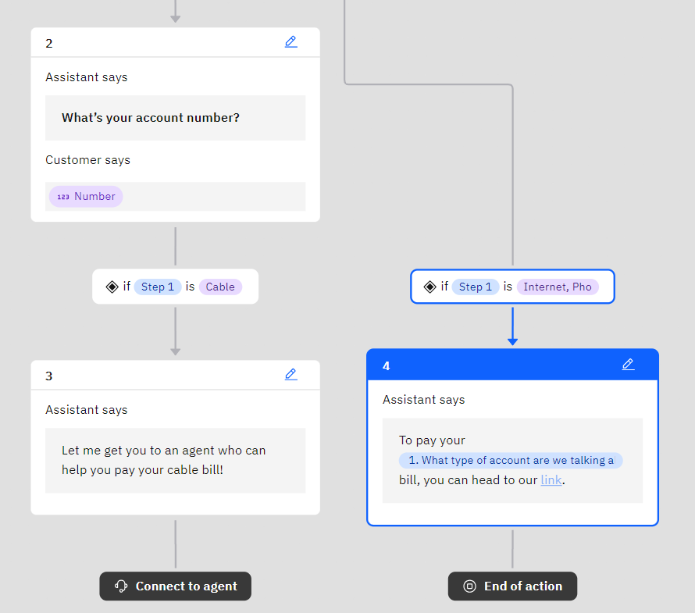
Use Visualization Tool

Slide 28
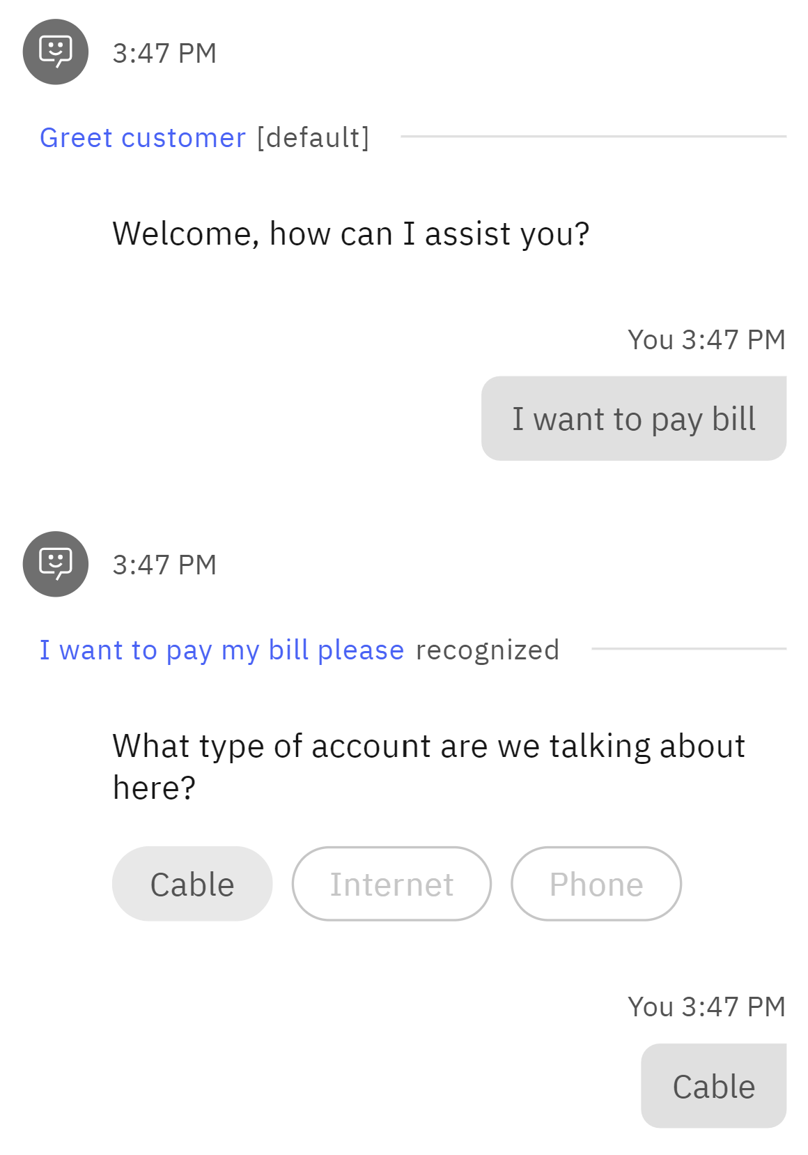
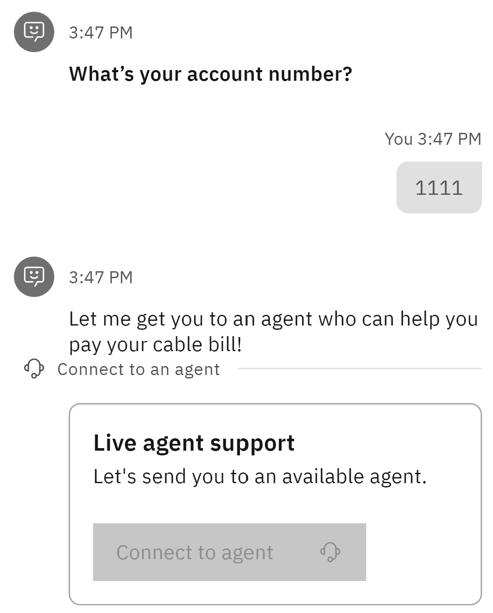
Preview Your Action

Slide 29
Integrate with Db2

Slide 30
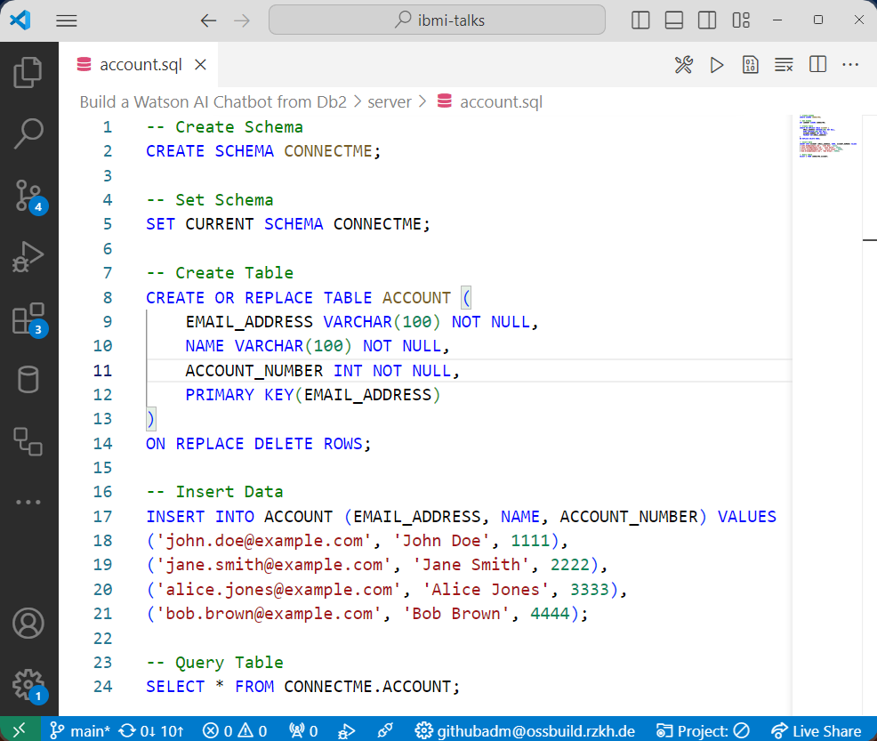
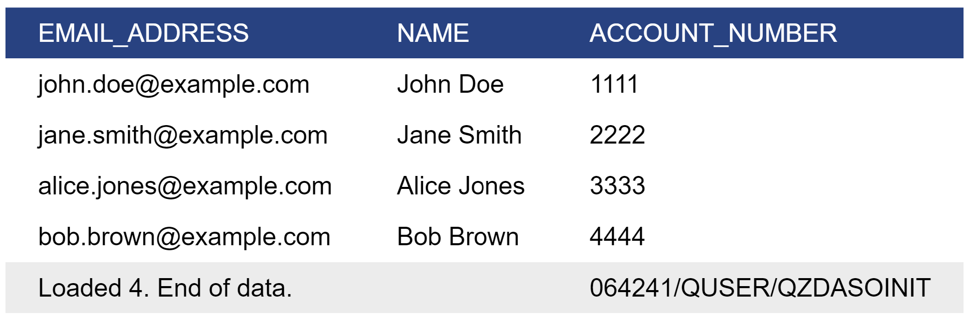
Create Table

Slide 31
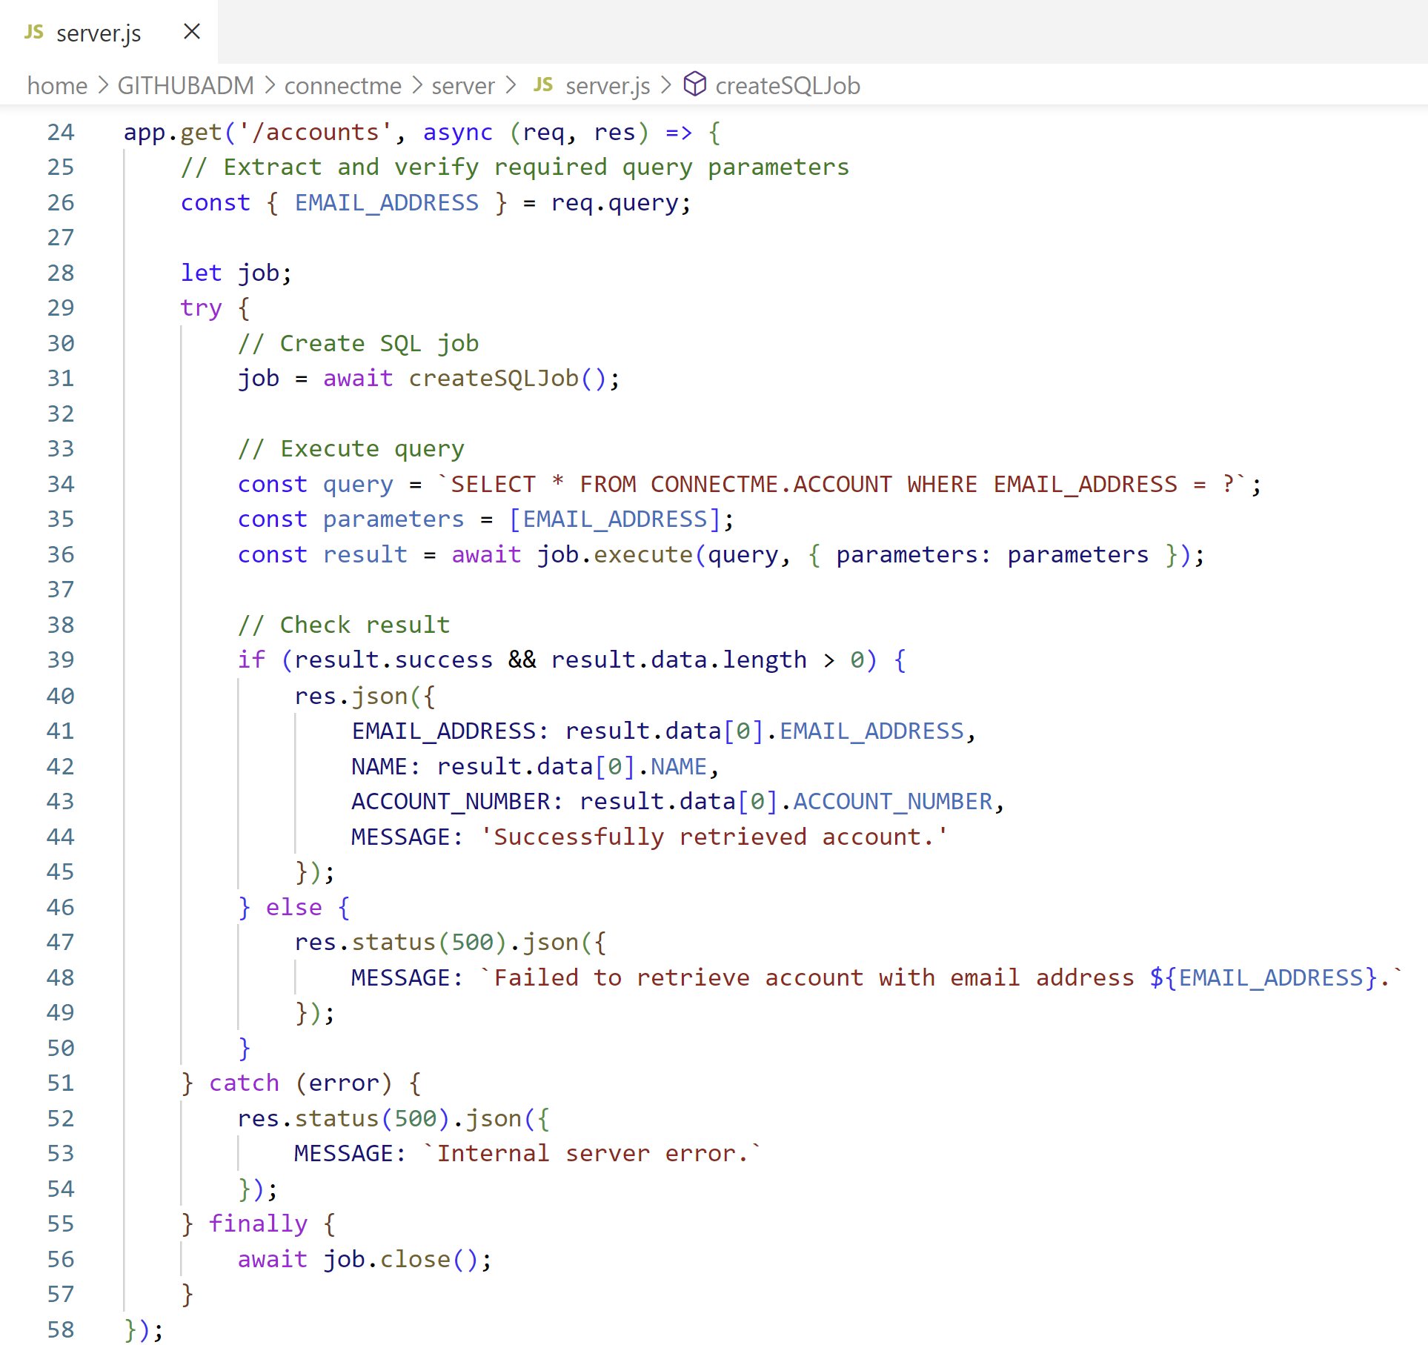
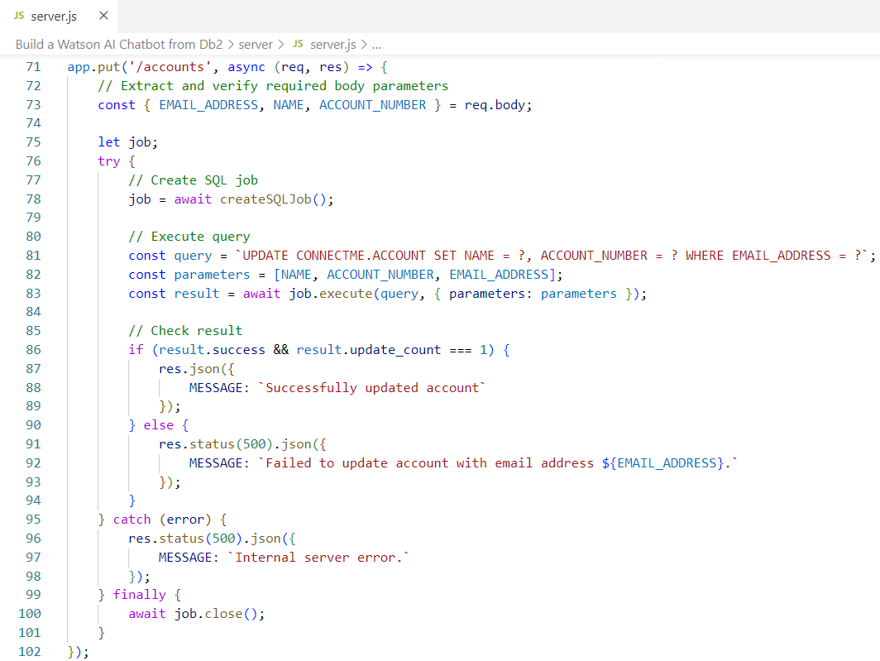
Create REST Server
👨🏻‍💻Server Source Code: server.js
SELECT * FROM CONNECTME.ACCOUNT WHERE EMAIL_ADDRESS = ?
UPDATE CONNECTME.ACCOUNT SET NAME = ?, ACCOUNT_NUMBER = ? WHERE EMAIL_ADDRESS = ?

Slide 32
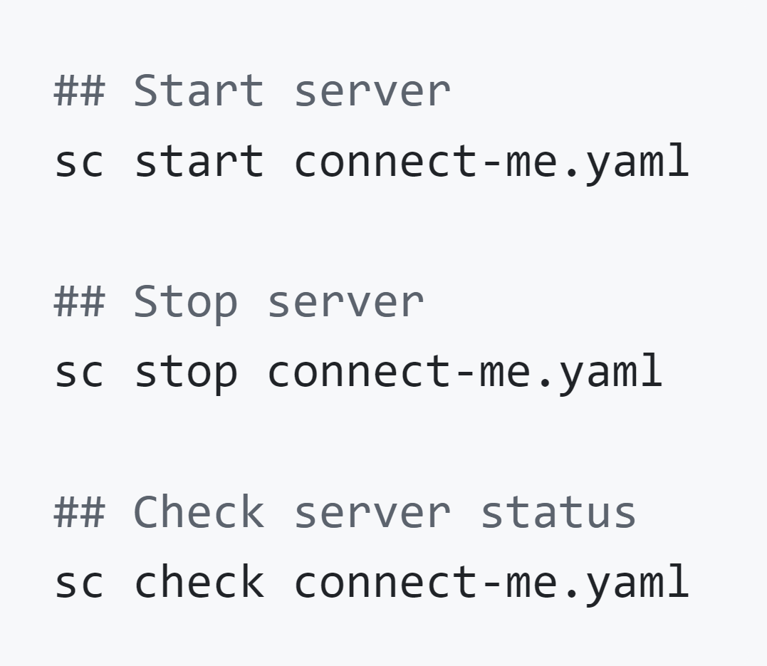
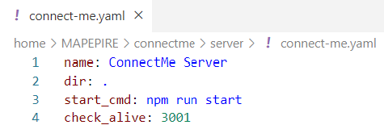
Create Service Commander Definition to Start Server
Service Commander A utility for managing services and applications running on IBM i

Slide 33
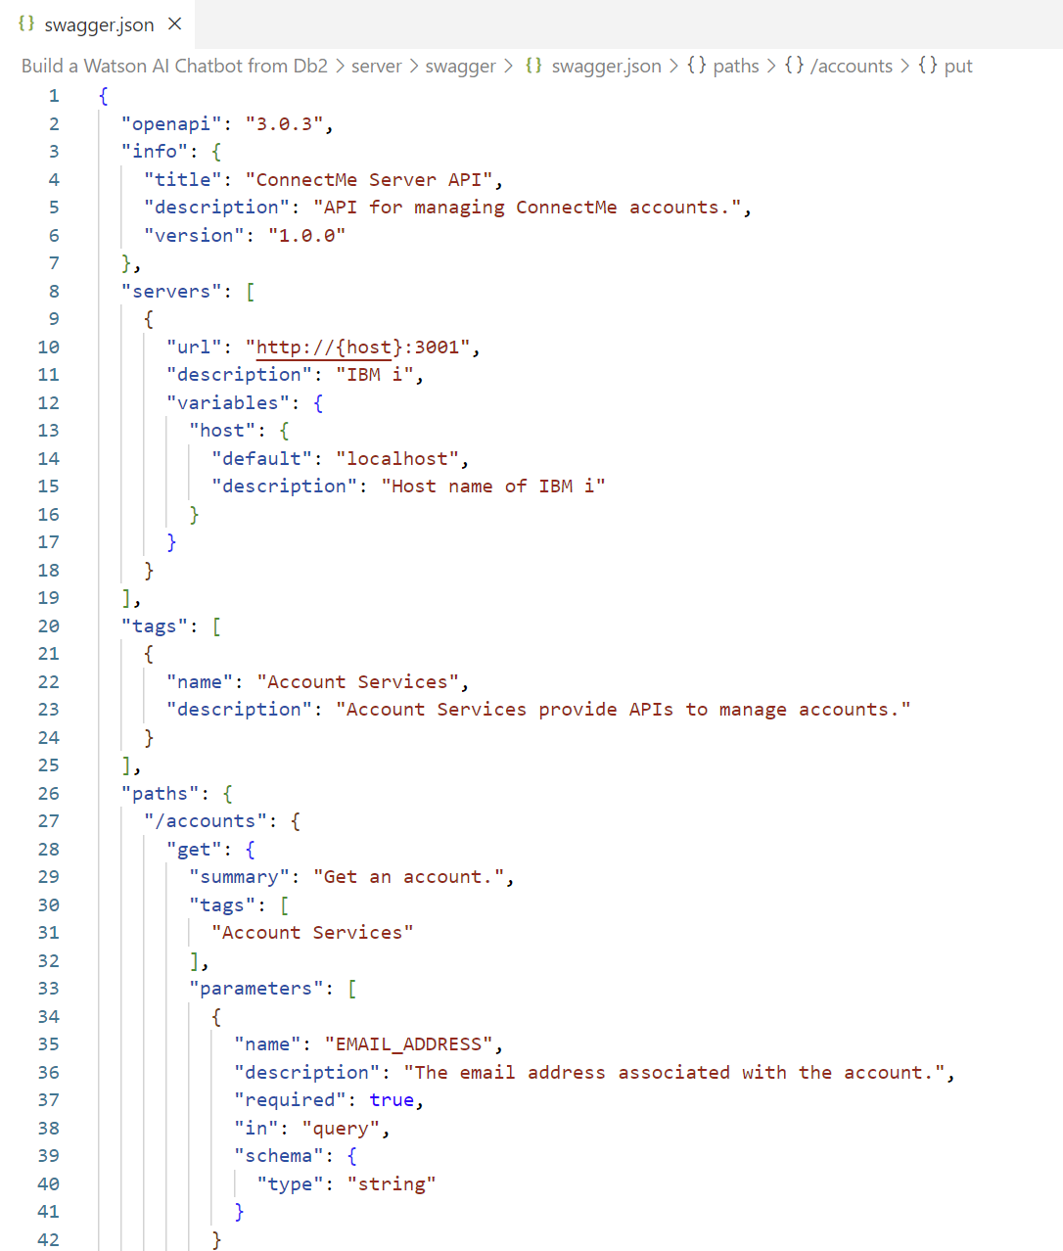
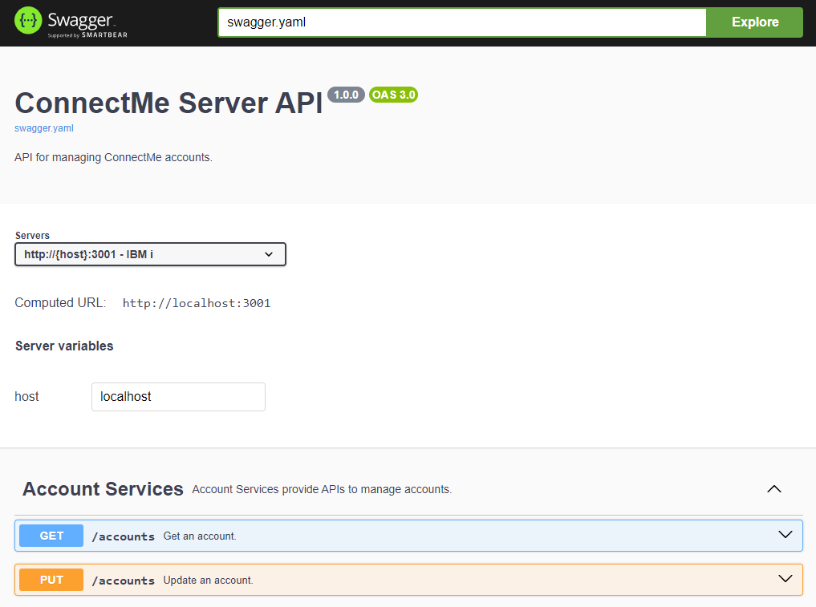
Create OpenAPI Specification (in JSON format)

Slide 34
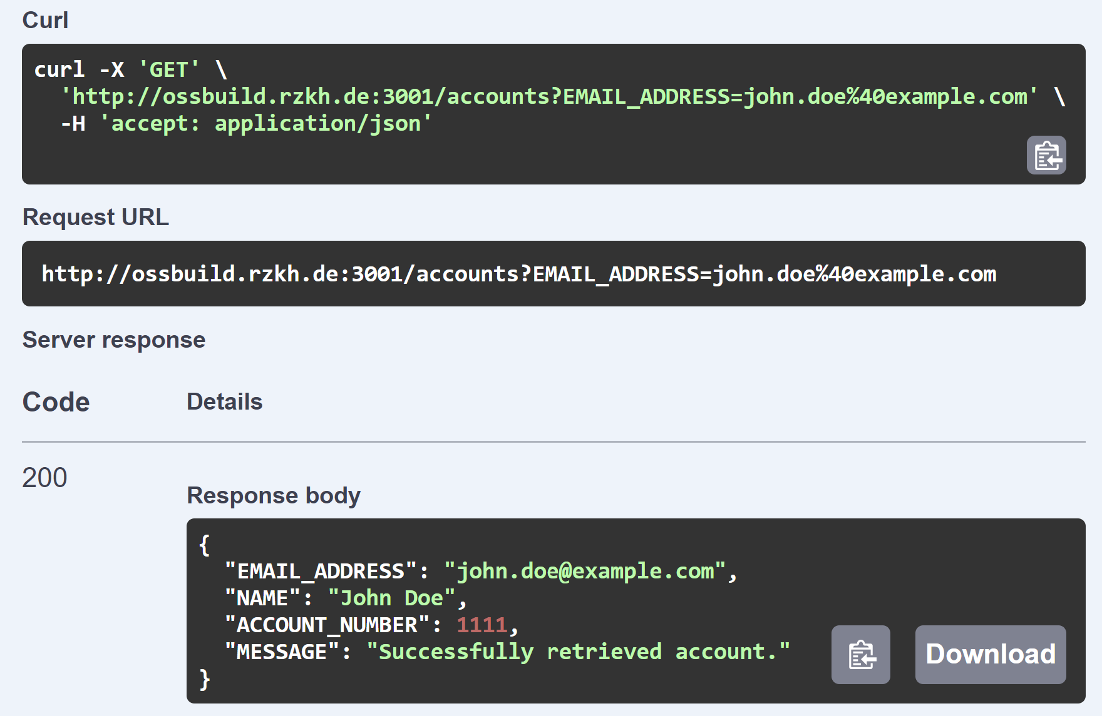
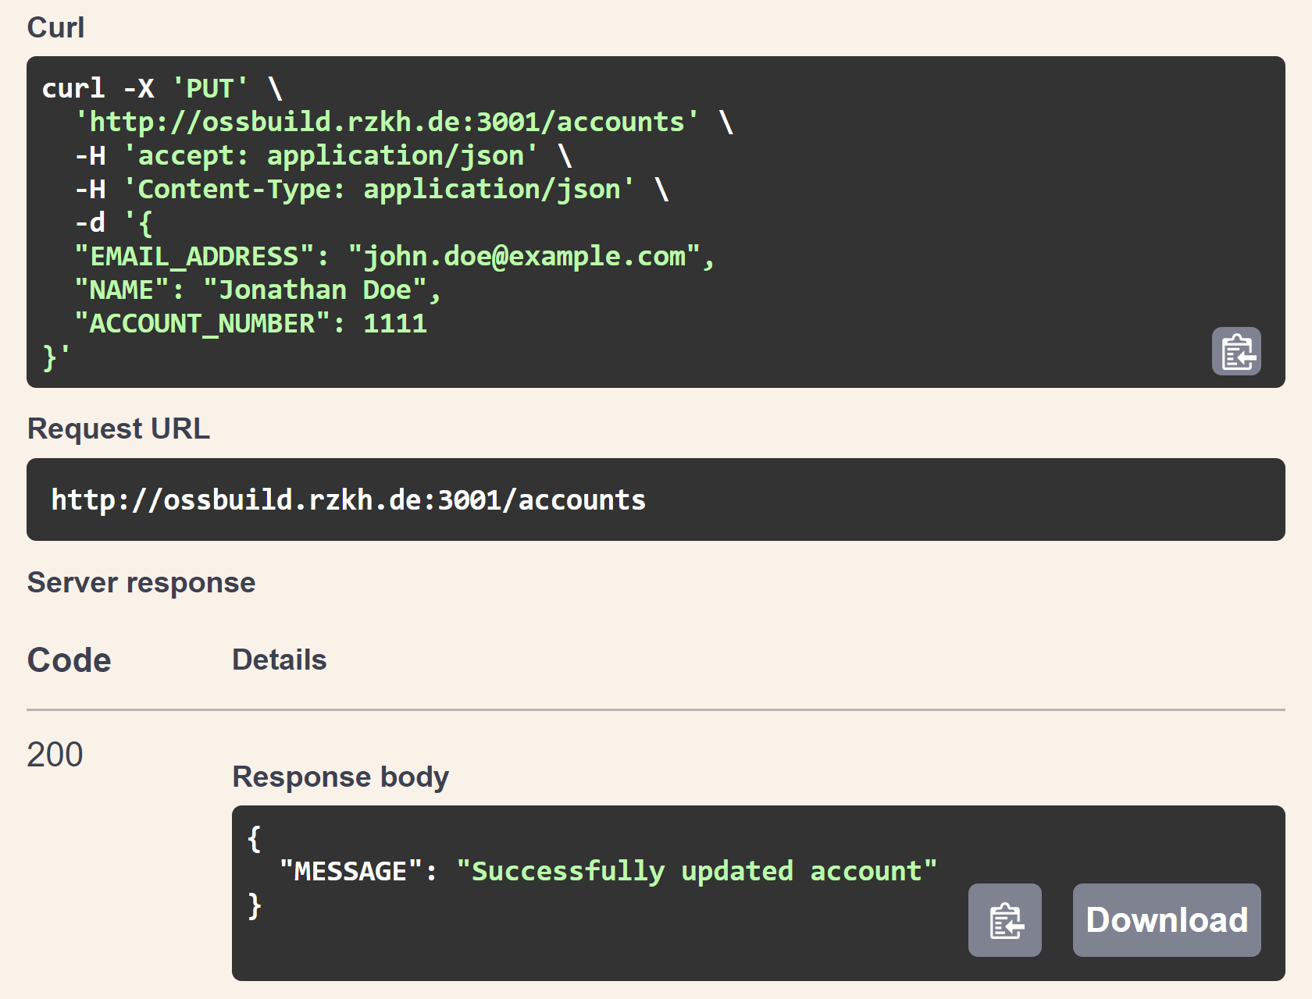
Test OpenAPI Specification

Slide 35
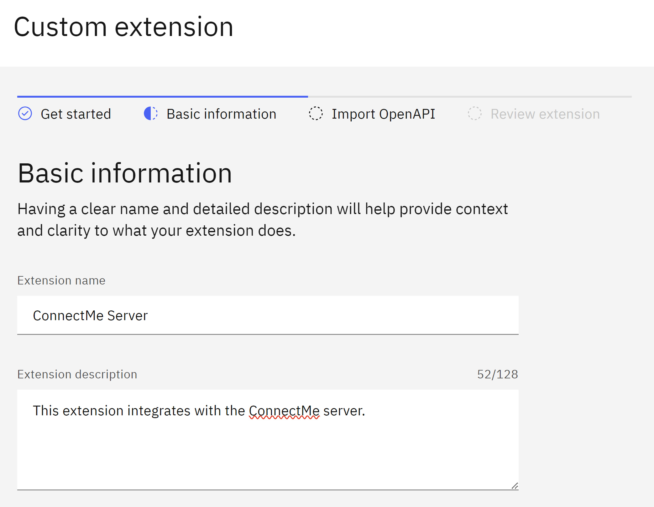
Build Custom Extension in Catelog

Slide 36
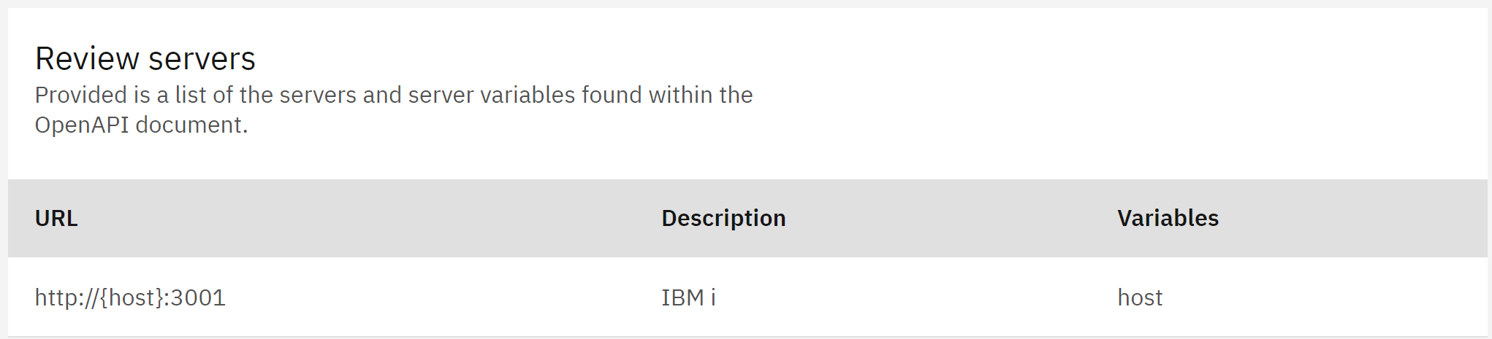
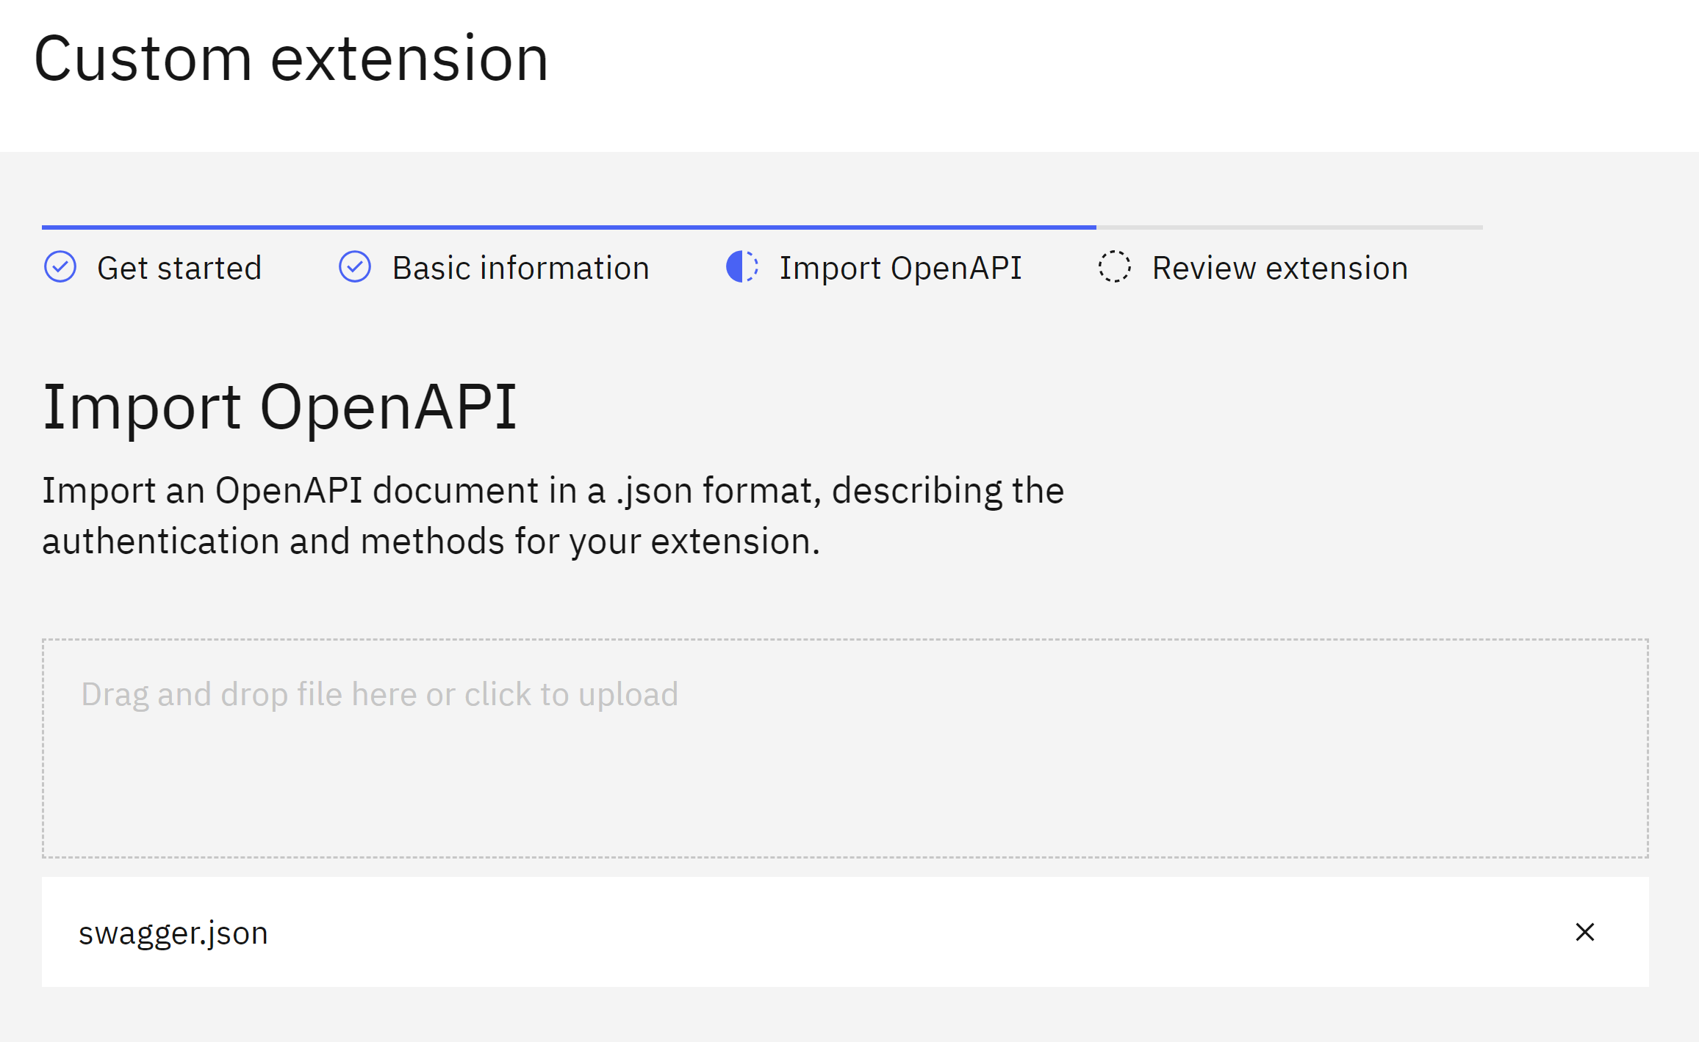
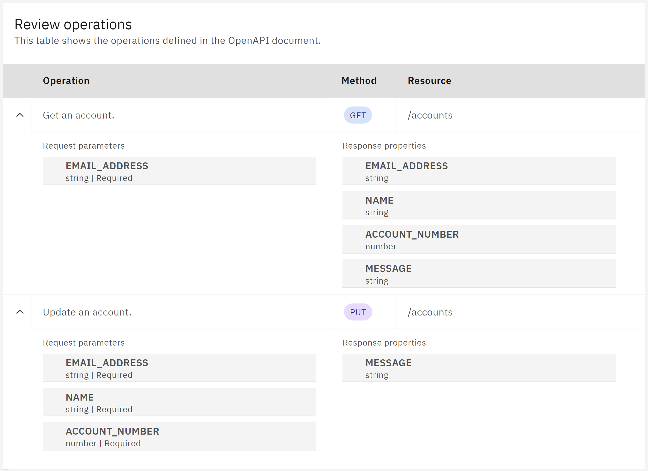
Import OpenAPI Specification

Slide 37
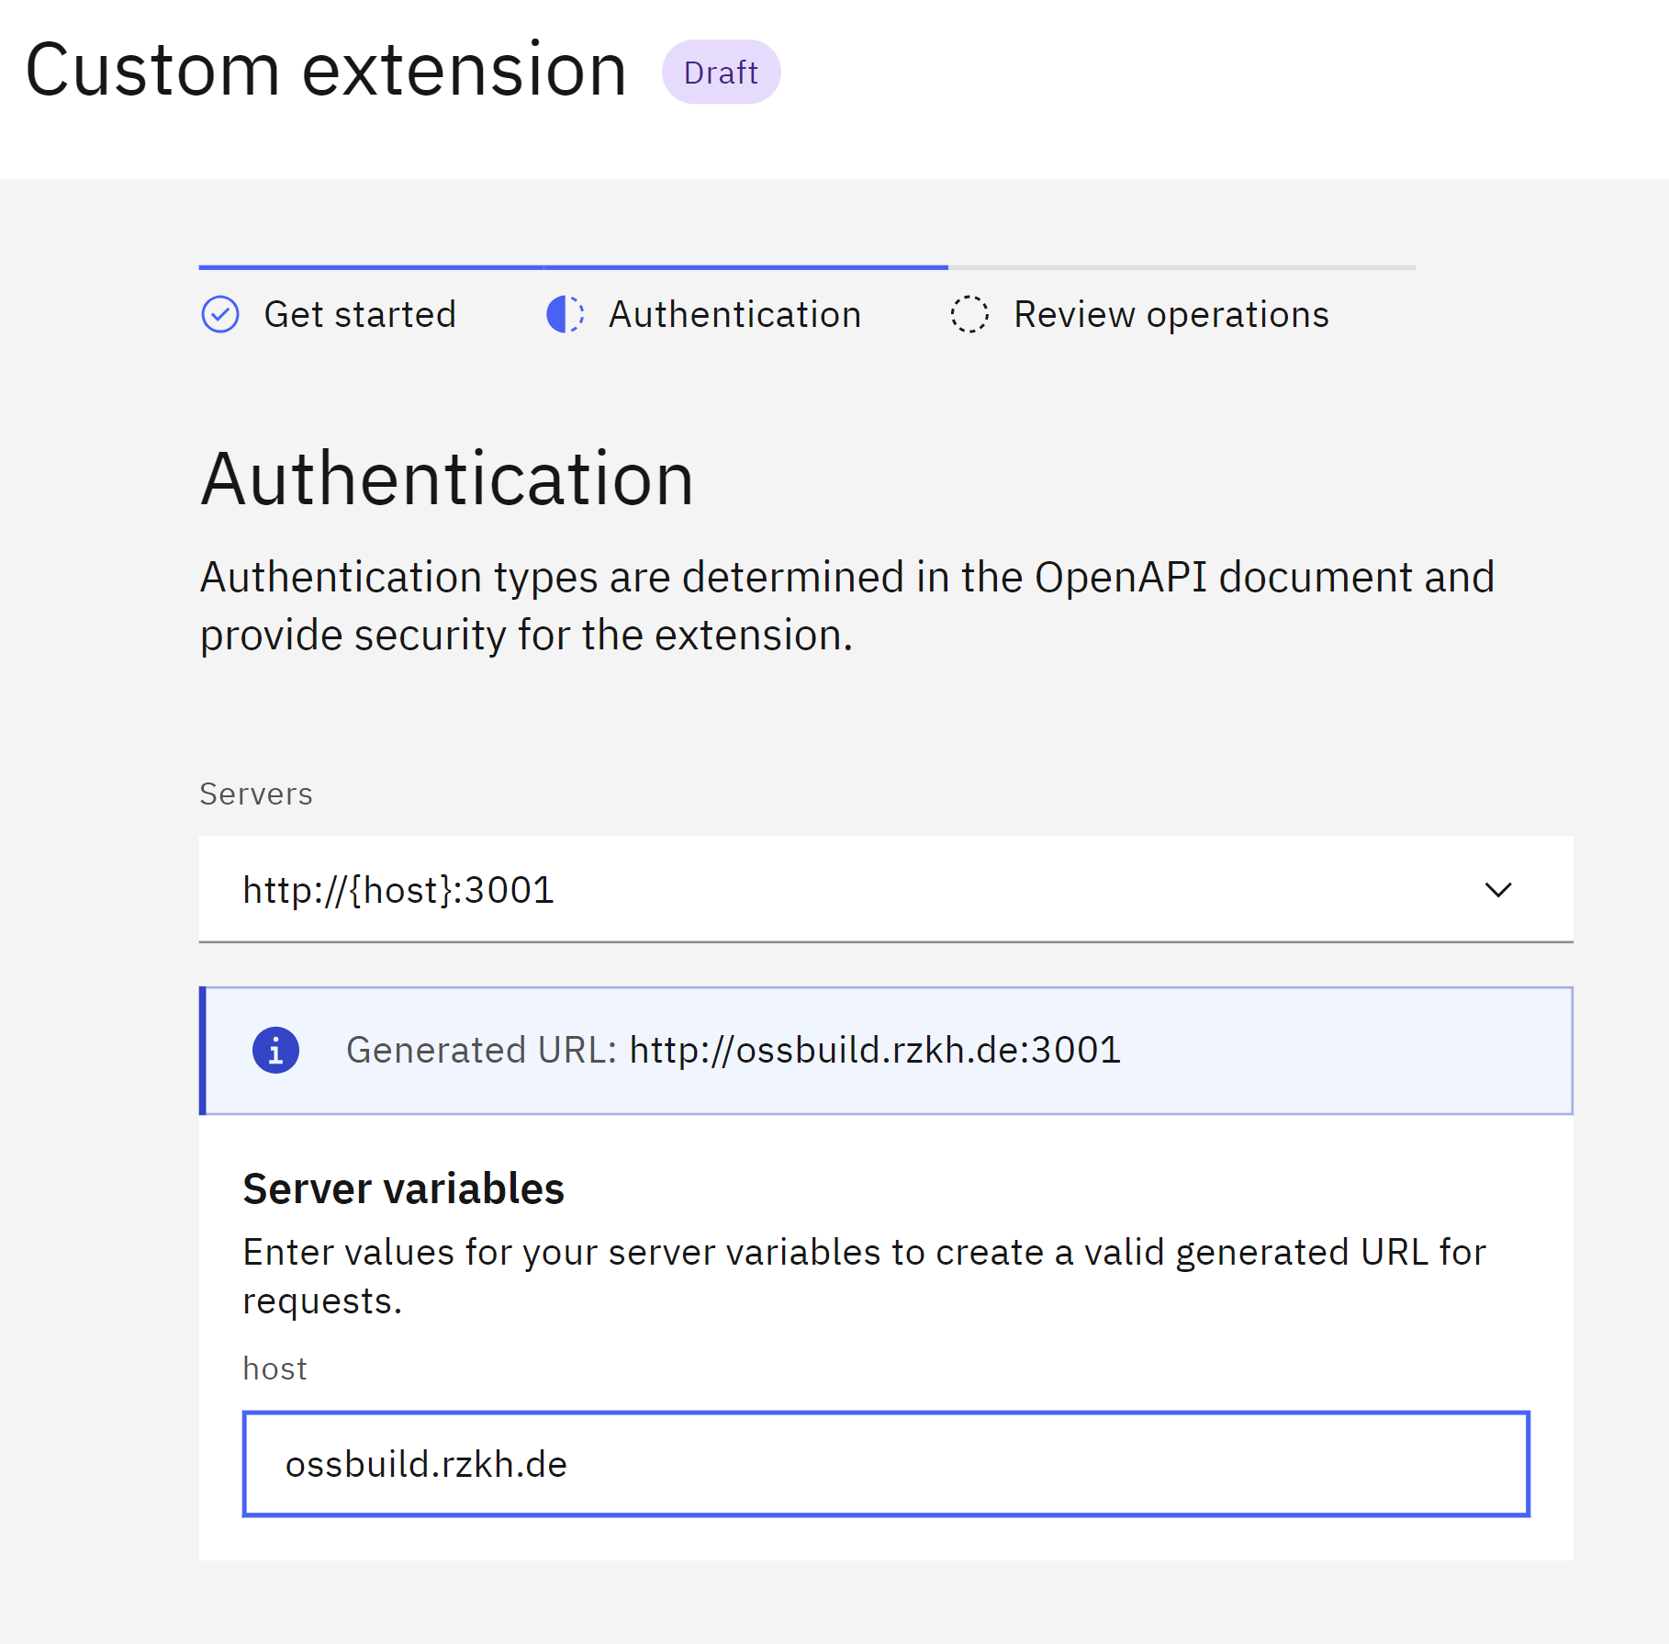
Add Extension to Watsonx Assistant

Slide 38
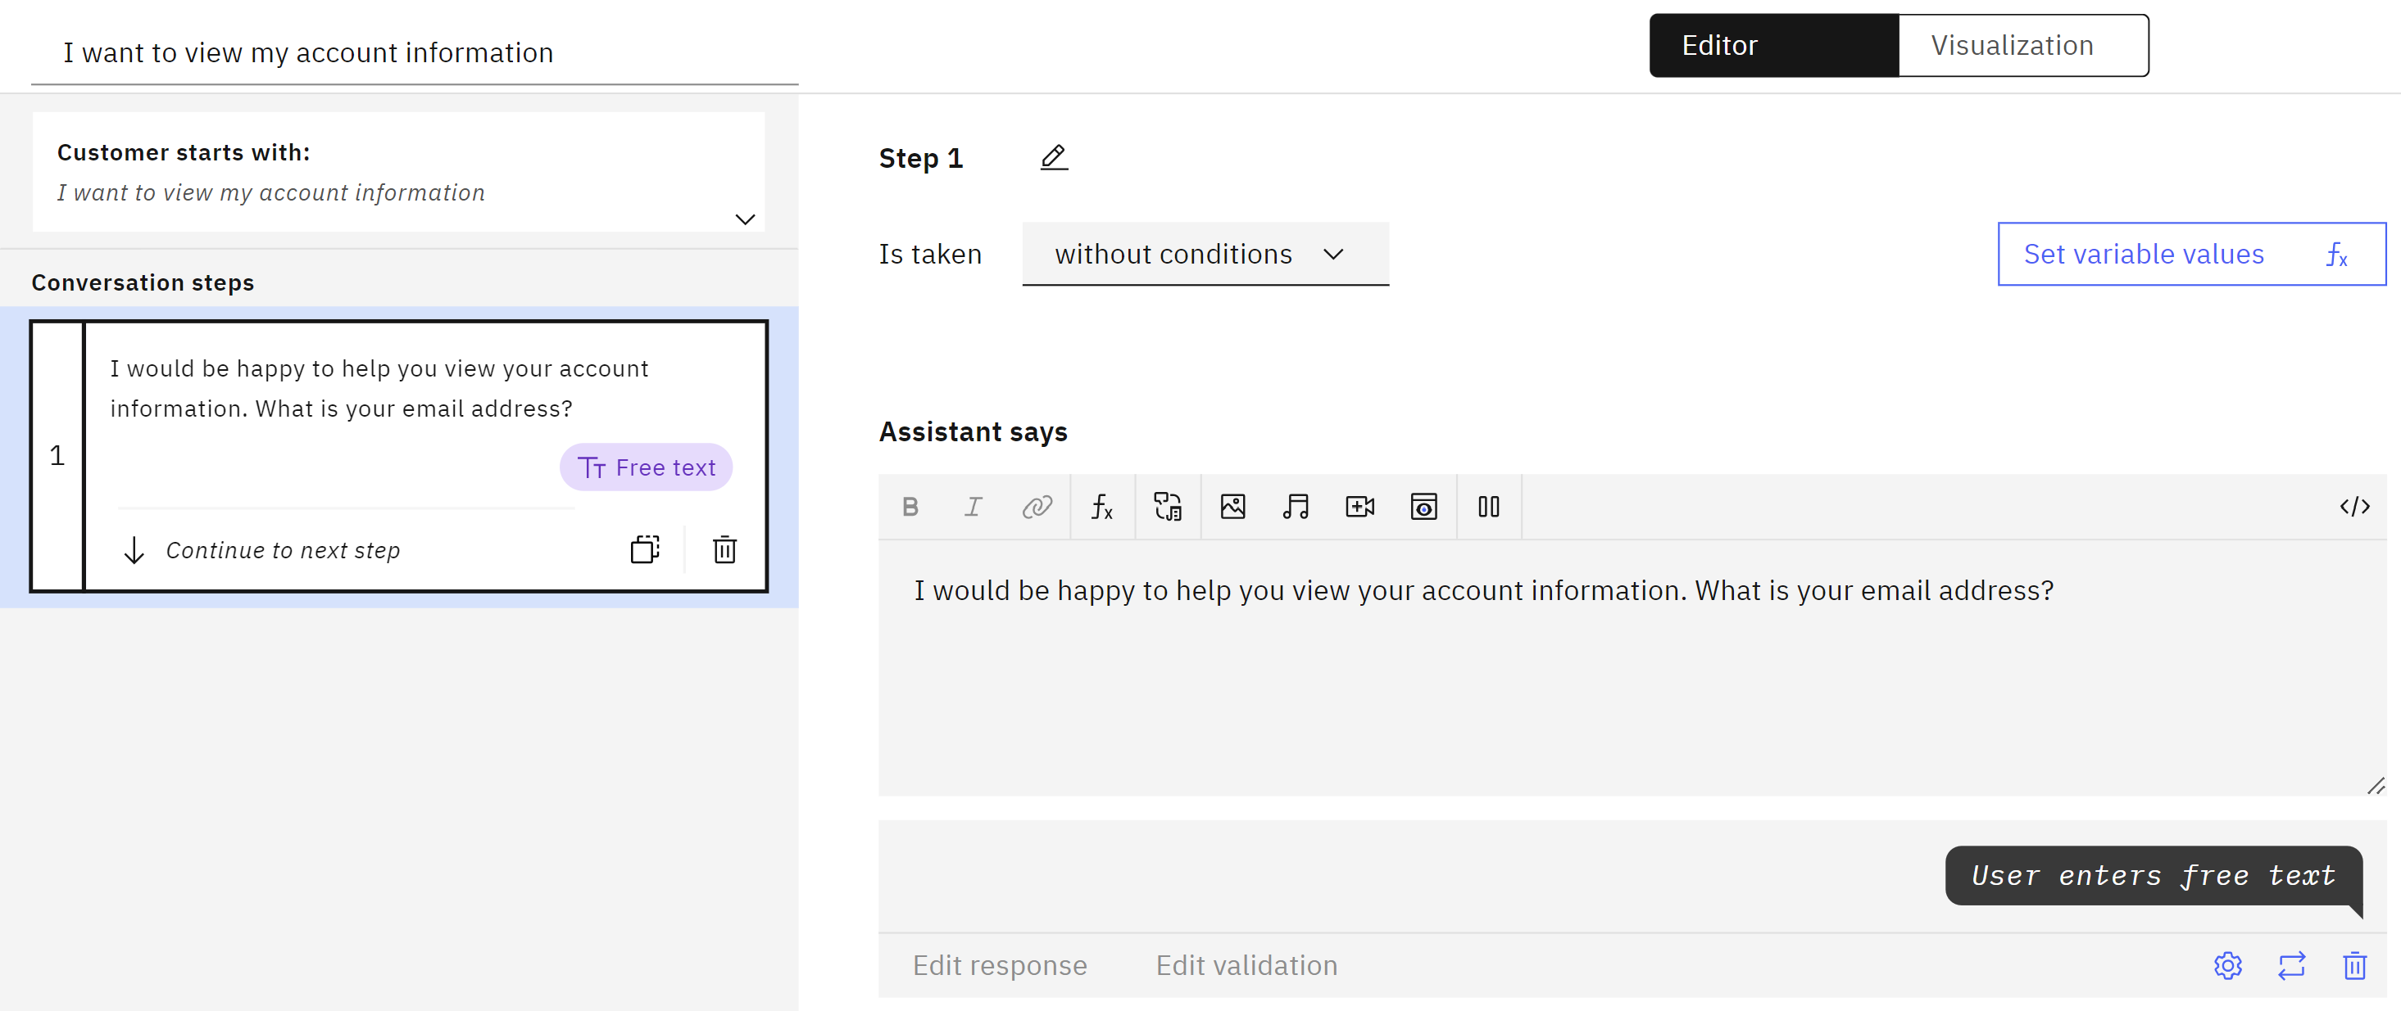
Create New Action with Initial Step

Slide 39
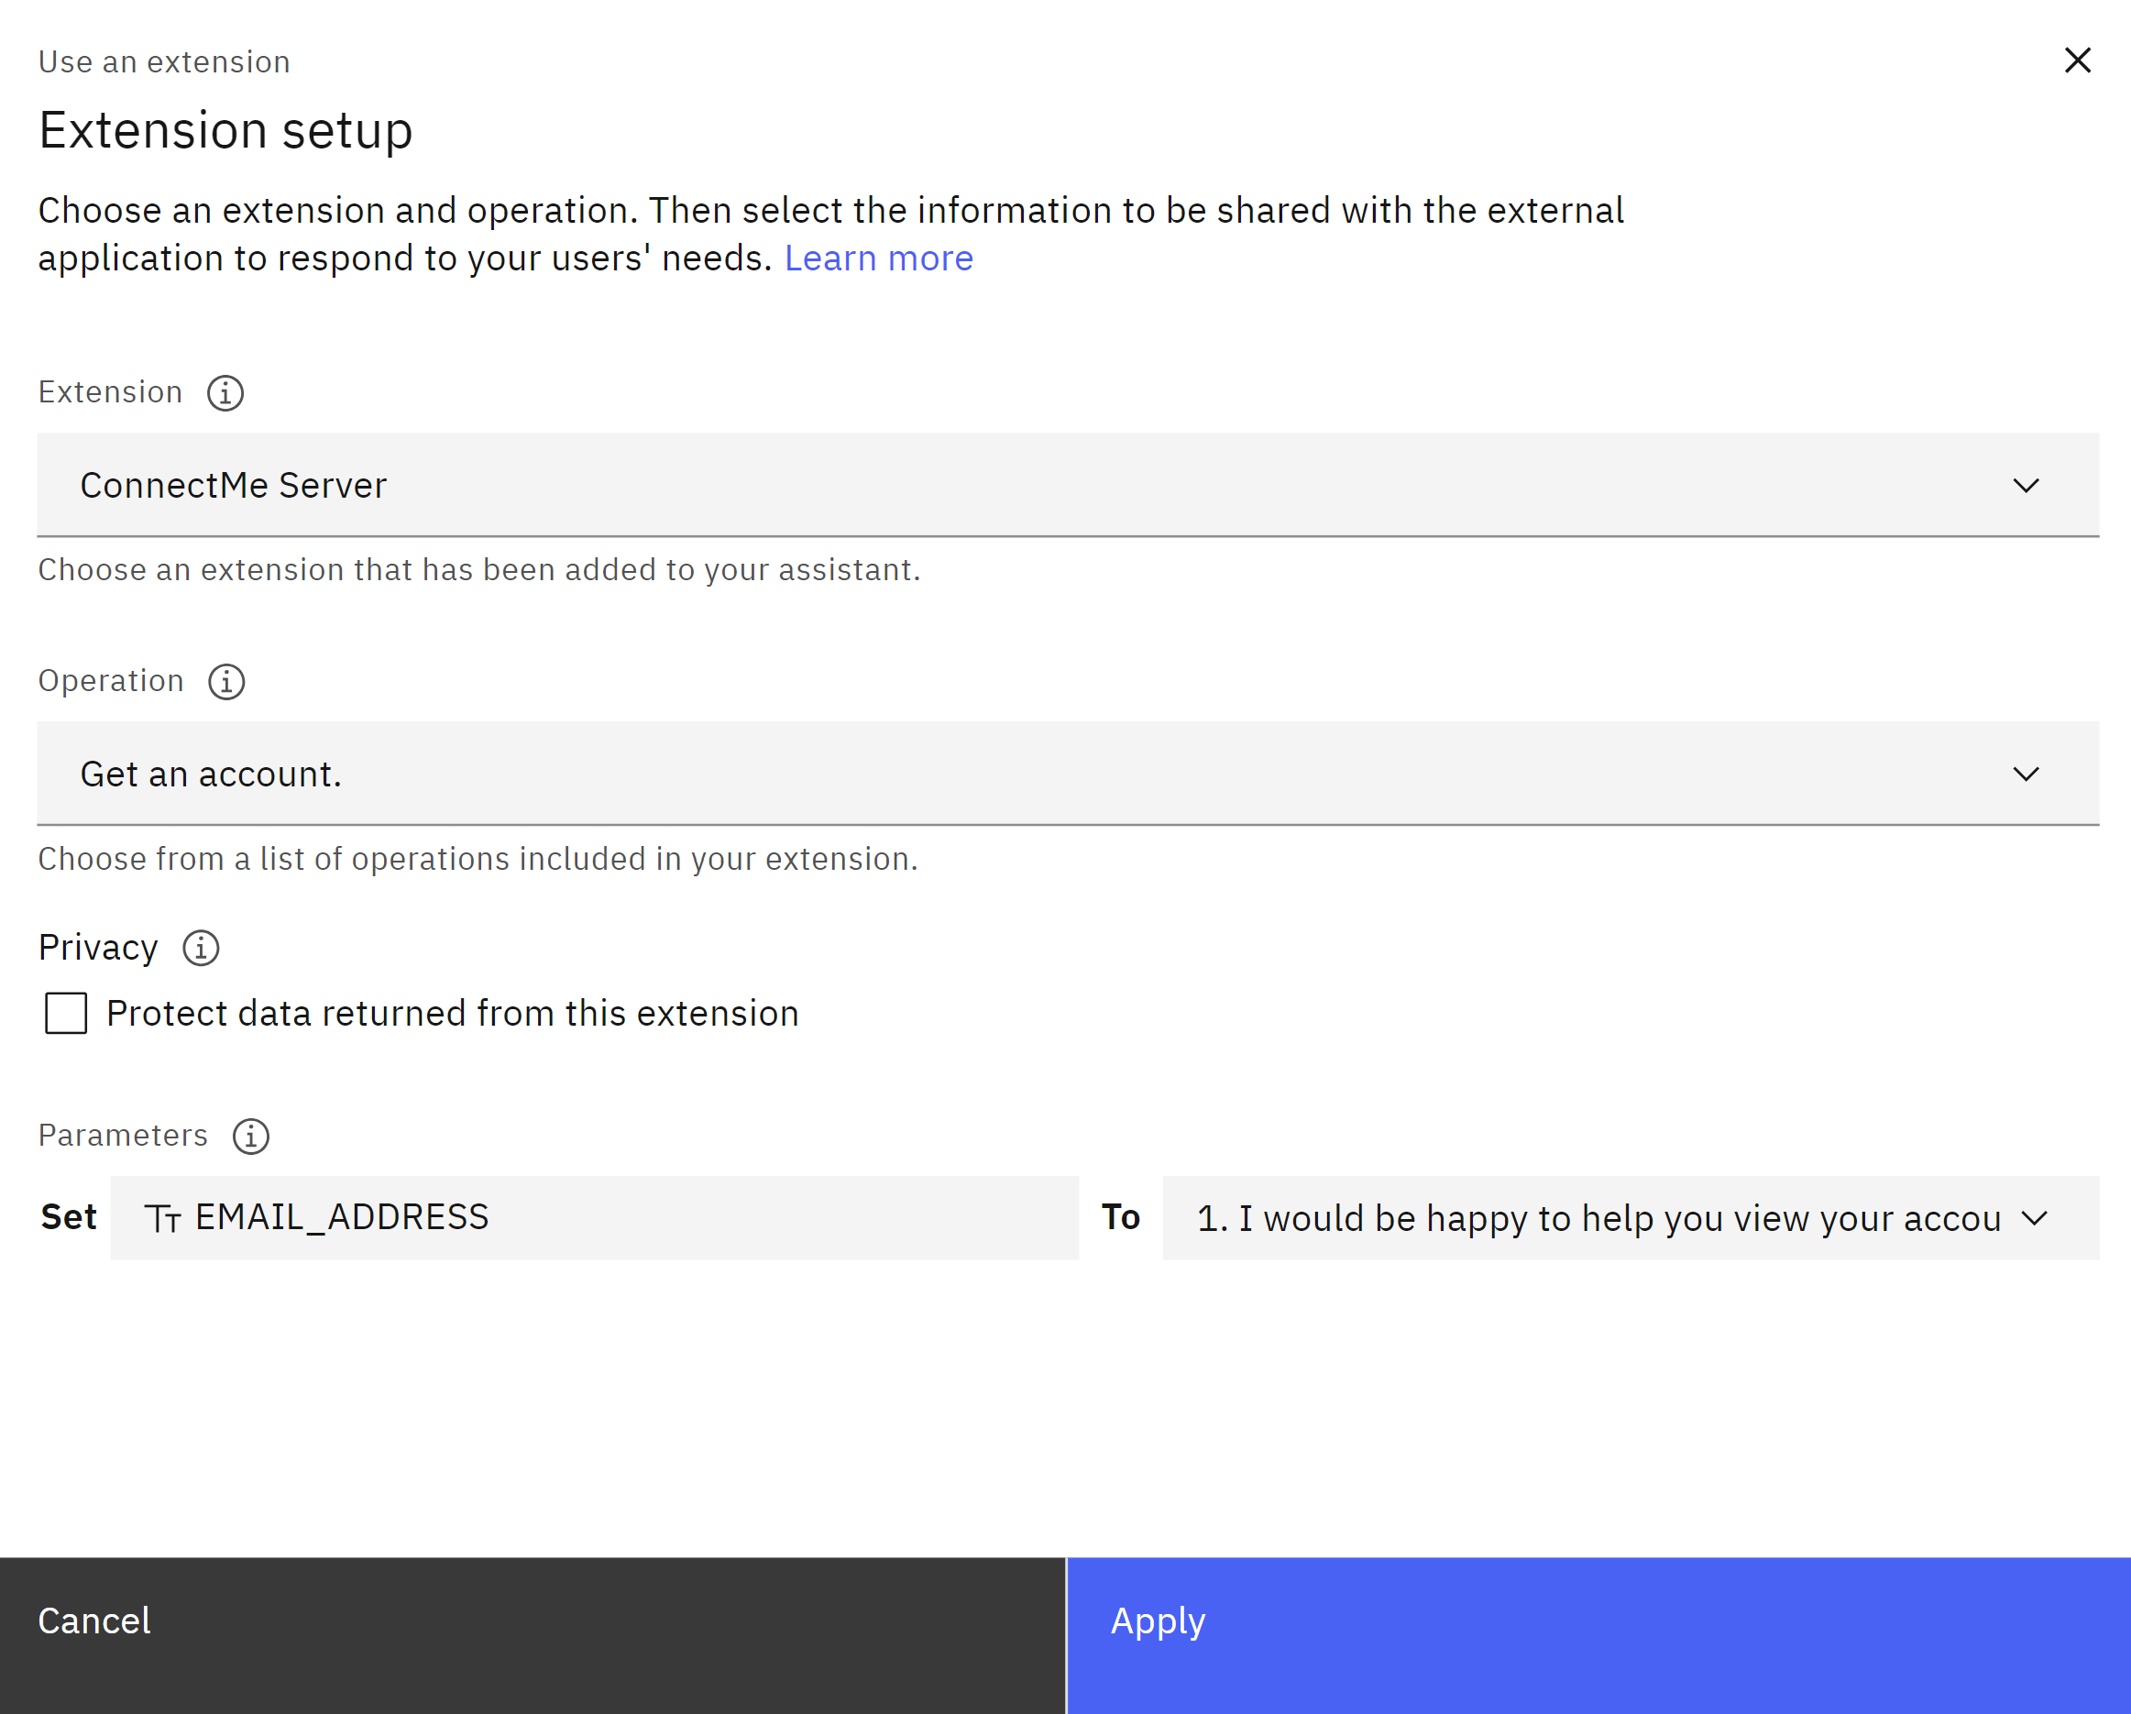
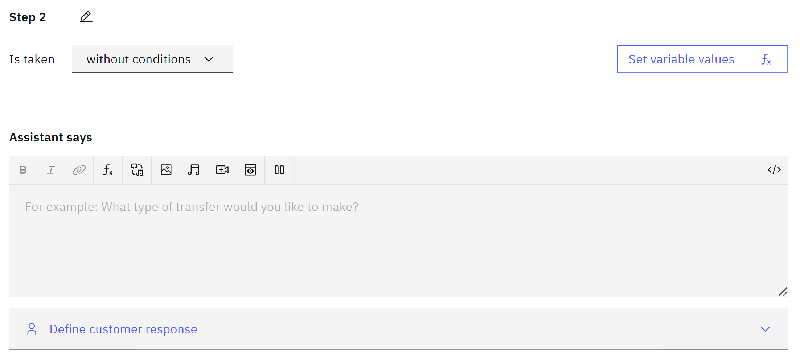
Create Step with Extension

Slide 40
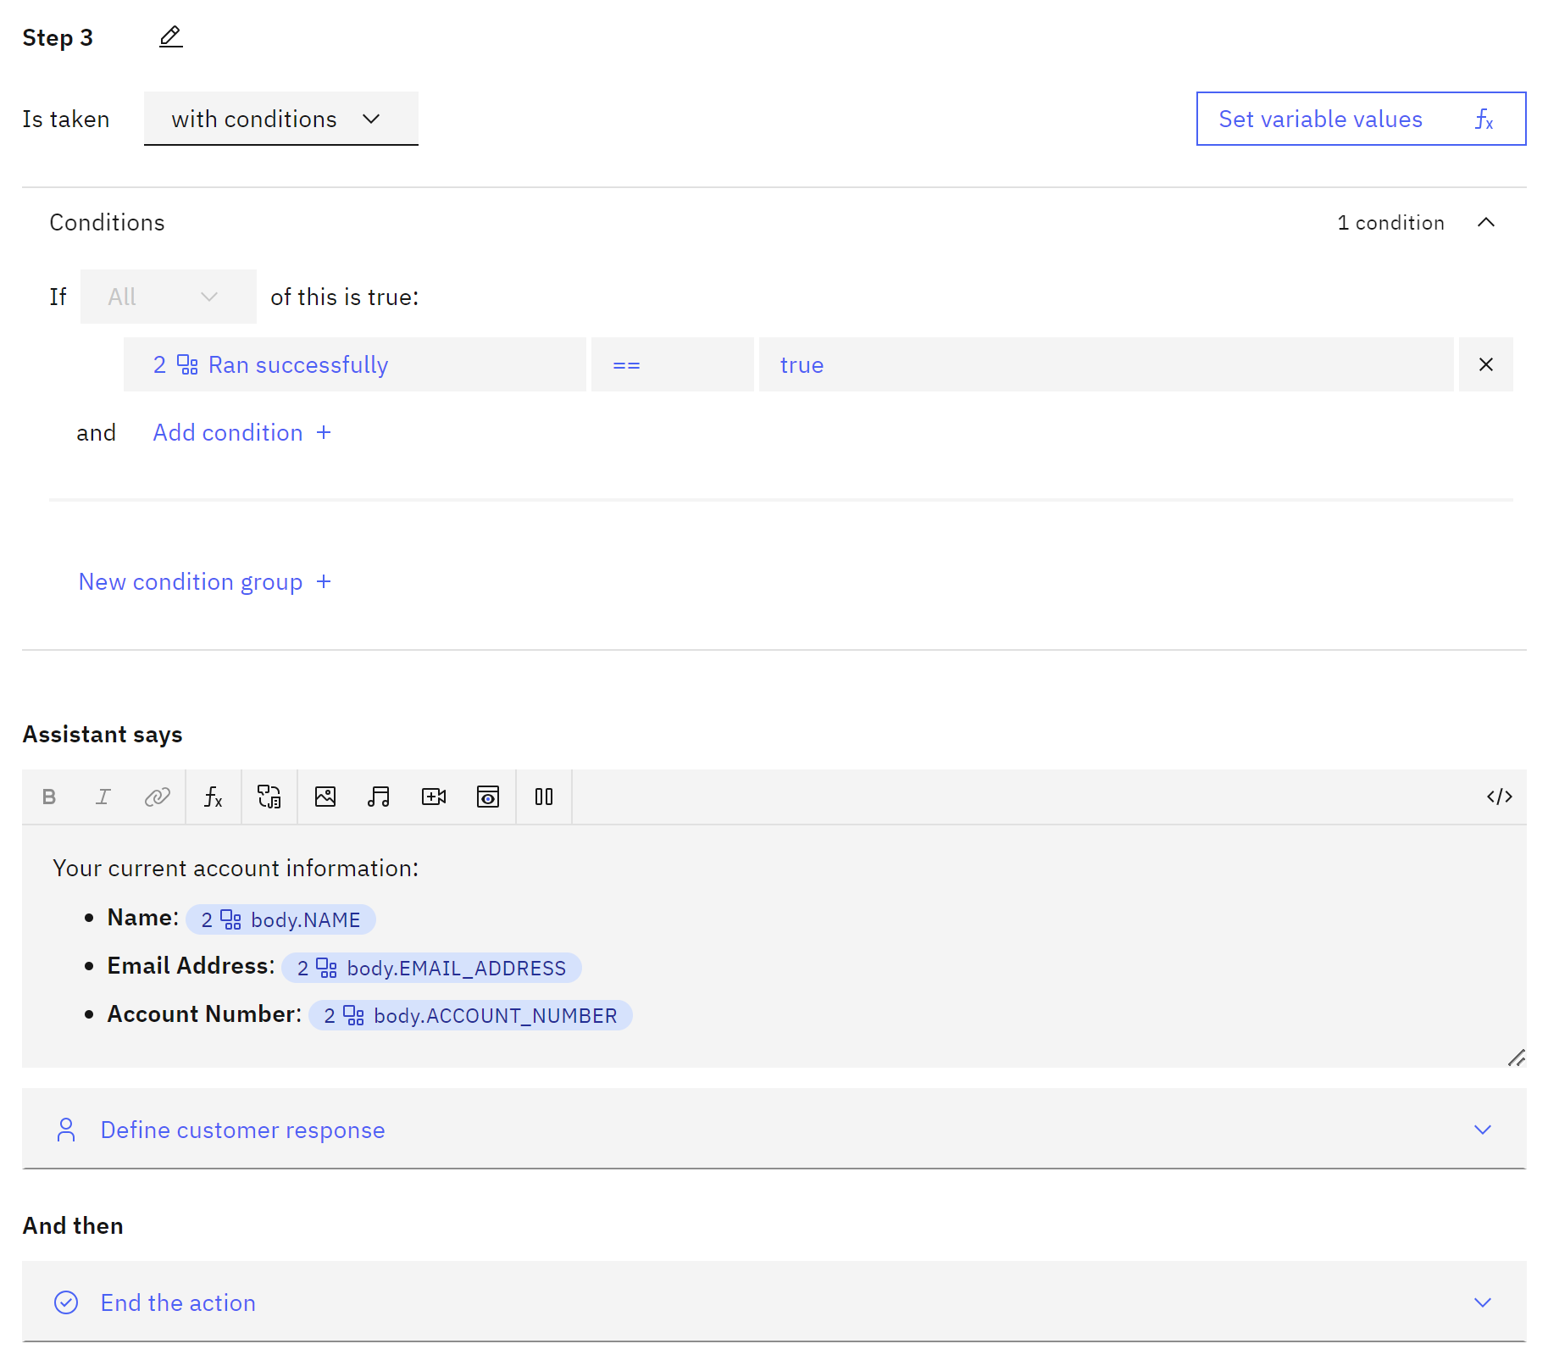
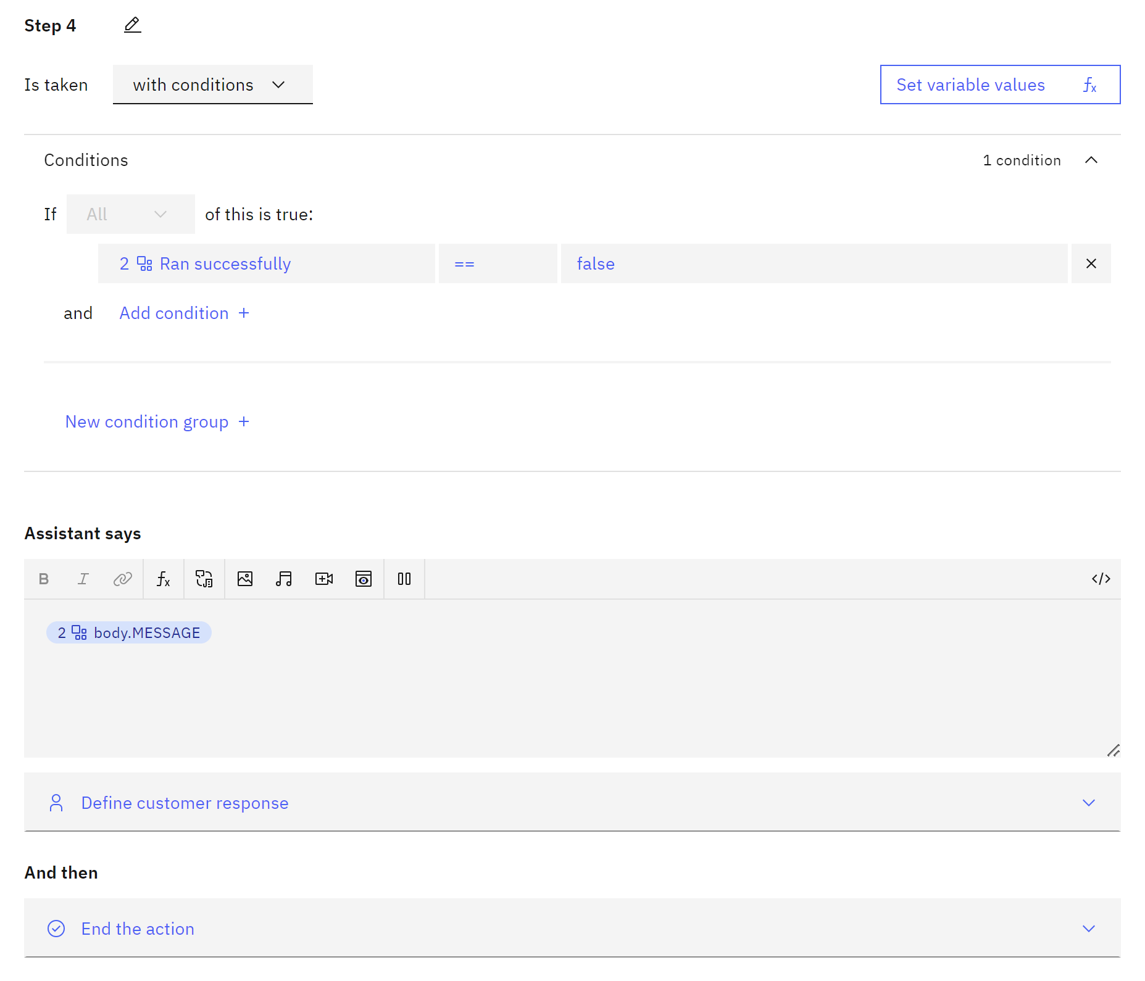
Create Success and Failure Steps
Extension Success
Extension Failure

Slide 41
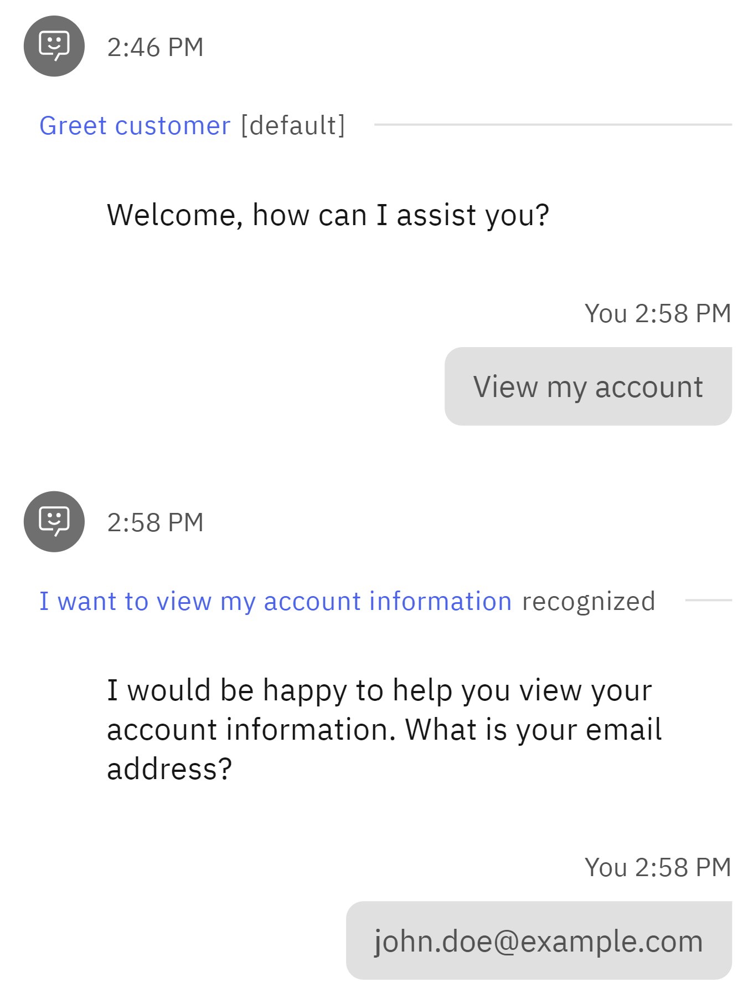

Preview Your Action

Slide 42


Duplicate Action and Update Phrase + Initial Step

Slide 43

Create Clarification Step

Slide 44


Create Step with Extension

Slide 45

Create Final Step

Slide 46



Preview Your Action

Slide 47
Next Steps

Slide 48

Add More Actions with Templates

Slide 49

Adjust Default Actions

Slide 50



Adjust Global Settings
Clarifying Questions
Show options when multiple actions seem to match what the customer wants
Change Conversation Topics Switch to other actions when customers ask about other topics
Intelligent Information Gathering The assistant retrieves and uses prior inputs to streamline the conversation

Slide 51



Search Integration with Watson Discovery
Search Integration Extend the scope of what your assistant can answer by searching documents and websites.

Slide 52
Any Questions?

Slide 54
For more information IBM Sites:
IBM i Home Page | https://www.ibm.com/it-infrastructure/power/os/ibm-i
IBM Strategy Whitepaper | https://www.ibm.com/it-infrastructure/us-en/resources/power/i-strategy-roadmap/
IBM Client Success | https://www.ibm.com/it-infrastructure/us-en/resources/power/ibm-i-customer-stories/
Support Life Cycle | https://www.ibm.com/support/lifecycle/
License Topics | https://www-01.ibm.com/support/docview.wss?uid=nas8N1022087
IBM i Release Life Cycle | https://www.ibm.com/support/pages/release-life-cycle
IBM i TR Wikis | IBM i Technology Updates

Slide 55
For more information:
Blogs to follow
More to follow
Hashtags to Use
TechChannel You and i (Steve Will)
TechChanneli-Can (Dawn May)
TechChannel: iTalk with Tuohy
TechChannel: OpenYour i with Jesse Gorzinski
IBM Db2 for i (Kent Milligian)
IBM i Analyitics Blog (Jon Westcott Jr)
iSee with Scott and Tim
@IBMservers
@COMMONug
@IBMChampions
@IBMSystemsISVs
@LinuxIBMMag
@OpenPOWERorg
@ITJungleNews
@SAPonIBMi
@SiDforIBMi
@IBMAIXeSupp
@IBMAIXdoc
#IBMPower
#IBMi #IBMAIX
#Power10 #LinuxonPower #HANAonPower
#ITinfrastructure #OpenSource #HybridCloud

Slide 57
Special notices
This document was developed for IBM offerings in the United States as of the date of publication. IBM may not make these offerings available in other countries, and the information is subject to change without notice. Consult your local IBM business contact for information on the IBM offerings available in your area.
Information in this document concerning non-IBM products was obtained from the suppliers of these products or other public sources. Questions on the capabilities of non-IBM products should be addressed to the suppliers of those products.
IBM may have patents or pending patent applications covering subject matter in this document. The furnishing of this document does not give you any license to these patents. Send license inquires, in writing, to IBM Director of Licensing, IBM Corporation, New Castle Drive, Armonk, NY 10504-1785 USA.
All statements regarding IBM future direction and intent are subject to change or withdrawal without notice, and represent goals and objectives only.
The information contained in this document has not been submitted to any formal IBM test and is provided "AS IS" with no warranties or guarantees either expressed or implied.
All examples cited or described in this document are presented as illustrations of the manner in which some IBM products can be used and the results that may be achieved. Actual environmental costs and performance characteristics will vary depending on individual client configurations and conditions.
IBM Global Financing offerings are provided through IBM Credit Corporation in the United States and other IBM subsidiaries and divisions worldwide to qualified commercial and government clients. Rates are based on a client's credit rating, financing terms, offering type, equipment type and options, and may vary by country. Other restrictions may apply. Rates and offerings are subject to change, extension or withdrawal without notice.
IBM is not responsible for printing errors in this document that result in pricing or information inaccuracies.
All prices shown are IBM's United States suggested list prices and are subject to change without notice; reseller prices may vary.
IBM hardware products are manufactured from new parts, or new and serviceable used parts. Regardless, our warranty terms apply.
Any performance data contained in this document was determined in a controlled environment. Actual results may vary significantly and are dependent on many factors including system hardware configuration and software design and configuration. Some measurements quoted in this document may have been made on development-level systems. There is no guarantee these measurements will be the same on generally-available systems. Some measurements quoted in this document may have been estimated through extrapolation. Users of this document should verify the applicable data for their specific environment.
Revised September 26, 2006

Slide 58
Special notices (cont.)
IBM, the IBM logo, ibm.com AIX, AIX (logo), AIX 5L, AIX 6 (logo), AS/400, BladeCenter, Blue Gene, ClusterProven, Db2, ESCON, i5/OS, i5/OS (logo), IBM Business Partner (logo), IntelliStation, LoadLeveler, Lotus, Lotus Notes, Notes, Operating System/400, OS/400, PartnerLink, PartnerWorld, PowerPC, pSeries, Rational, RISC System/6000, RS/6000, THINK, Tivoli, Tivoli (logo), Tivoli Management Environment, WebSphere, xSeries, z/OS, zSeries, Active Memory, Balanced Warehouse, CacheFlow, Cool Blue, IBM Systems Director VMControl, pureScale, TurboCore, Chiphopper, Cloudscape, Db2 Universal Database, DS4000, DS6000, DS8000, EnergyScale, Enterprise Workload Manager, General Parallel File System, , GPFS, HACMP, HACMP/6000, HASM, IBM Systems Director Active Energy Manager, iSeries, Micro-Partitioning, POWER, PowerExecutive, PowerVM, PowerVM (logo), PowerHA, Power Architecture, Power Everywhere, Power Family, POWER Hypervisor, Power Systems, Power Systems (logo), Power Systems Software, Power Systems Software (logo), POWER2, POWER3, POWER4, POWER4+, POWER5, POWER5+, POWER6, POWER6+, POWER7, System i, System p, System p5, System Storage, System z, TME 10, Workload Partitions Manager and X-Architecture are trademarks or registered trademarks of International Business Machines Corporation in the United States, other countries, or both. If these and other IBM trademarked terms are marked on their first occurrence in this information with a trademark symbol (® or ™), these symbols indicate U.S. registered or common law trademarks owned by IBM at the time this information was published. Such trademarks may also be registered or common law trademarks in other countries.
A full list of U.S. trademarks owned by IBM may be found at: http://www.ibm.com/legal/copytrade.shtml.
Adobe, the Adobe logo, PostScript, and the PostScript logo are either registered trademarks or trademarks of Adobe Systems Incorporated in the United States, and/or other countries.
AltiVec is a trademark of Freescale Semiconductor, Inc.
AMD Opteron is a trademark of Advanced Micro Devices, Inc.
InfiniBand, InfiniBand Trade Association and the InfiniBand design marks are trademarks and/or service marks of the InfiniBand Trade Association.
Intel, Intel logo, Intel Inside, Intel Inside logo, Intel Centrino, Intel Centrino logo, Celeron, Intel Xeon, Intel SpeedStep, Itanium, and Pentium are trademarks or registered trademarks of Intel Corporation or its subsidiaries in the United States and other countries.
IT Infrastructure Library is a registered trademark of the Central Computer and Telecommunications Agency which is now part of the Office of Government Commerce.
Java and all Java-based trademarks and logos are trademarks or registered trademarks of Oracle and/or its affiliates.
Linear Tape-Open, LTO, the LTO Logo, Ultrium, and the Ultrium logo are trademarks of HP, IBM Corp. and Quantum in the U.S. and other countries.
Linux is a registered trademark of Linus Torvalds in the United States, other countries or both.
Microsoft, Windows and the Windows logo are registered trademarks of Microsoft Corporation in the United States, other countries or both.
NetBench is a registered trademark of Ziff Davis Media in the United States, other countries or both.
SPECint, SPECfp, SPECjbb, SPECweb, SPECjAppServer, SPEC OMP, SPECviewperf, SPECapc, SPEChpc, SPECjvm, SPECmail, SPECimap and SPECsfs are trademarks of the Standard Performance Evaluation Corp (SPEC).
The Power Architecture and Power.org wordmarks and the Power and Power.org logos and related marks are trademarks and service marks licensed by Power.org.
TPC-C and TPC-H are trademarks of the Transaction Performance Processing Council (TPPC).
UNIX is a registered trademark of The Open Group in the United States, other countries or both.
Other company, product and service names may be trademarks or service marks of others.
Revised December 2, 2010

